Slide 1
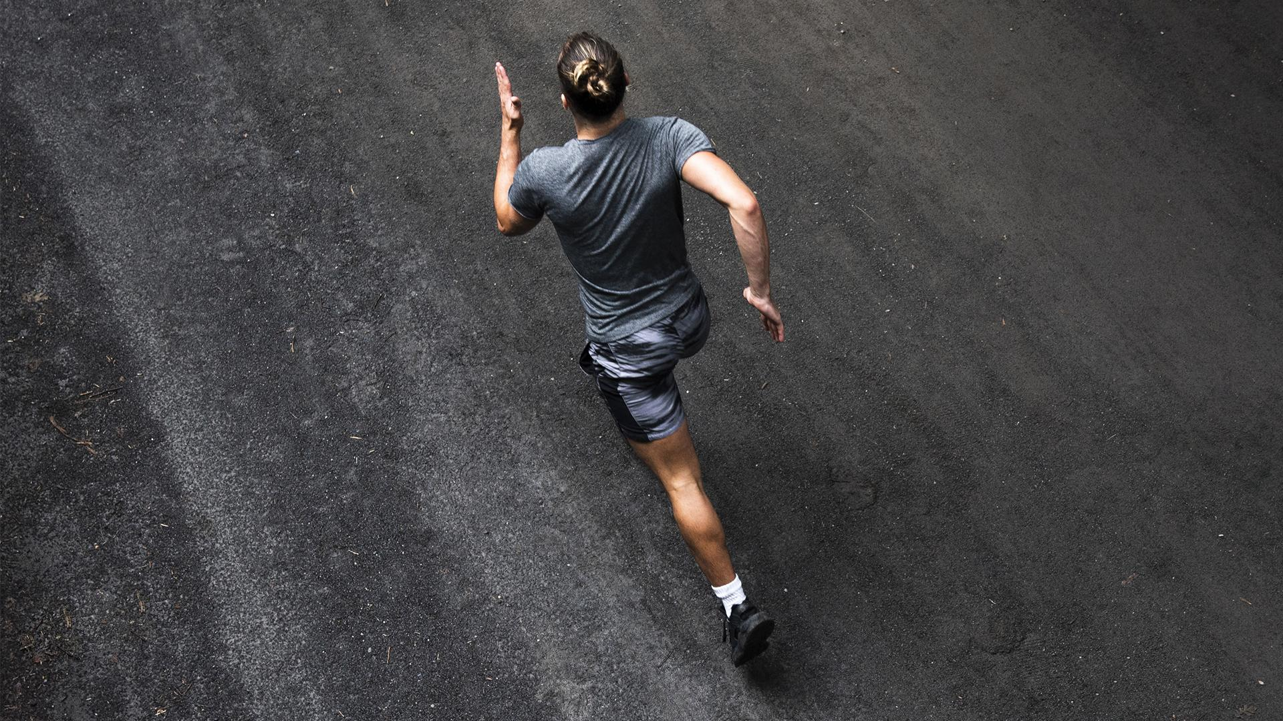
CONSUMER BEHAVIOR
V Varsha 203011T
Tey Jia Ying 202704D
Hu Shi Yao 202170F
Notes:
Good afternoon Ms Chan, I am Varsha and together with Jia Ying and Shi Yao we will be presenting our consumer behavior assignment

Slide 2

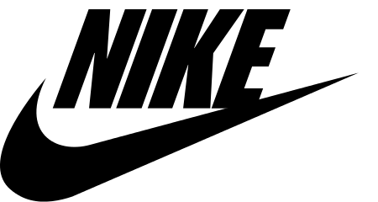
Chosen Brands
Market Oriented
Identify needs & desires of consumers → create products that satisfy them

Slide 3
01
LOG0
Nike VS Adidas

Slide 4


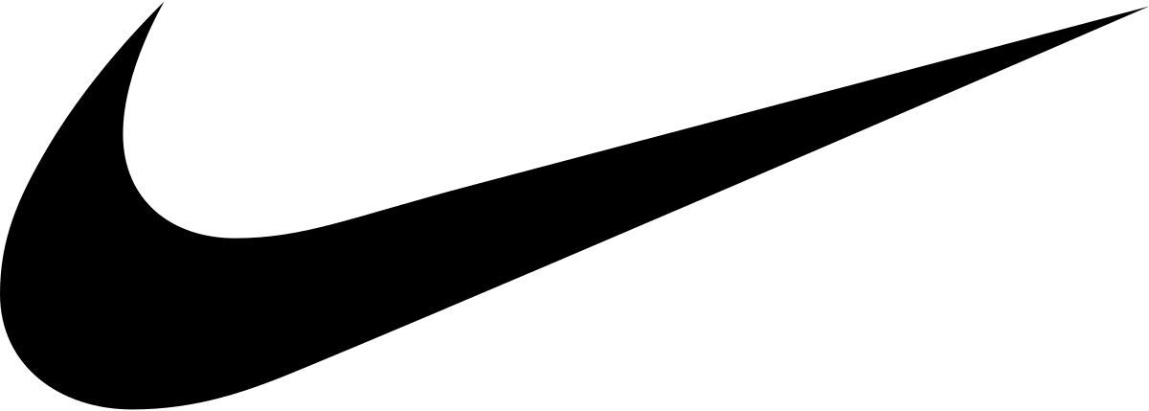


NIKE
LOGO
ADIDAS
Notes:
Before, I begin, let me ask you a question, if say “Nike” what logo comes to your mind? Im pretty sure it would be the iconic swoosh. But if I say Adidas, what logo comes to your mind? Is it the mountain or the trefoil? Or even one of these 2?

Slide 5


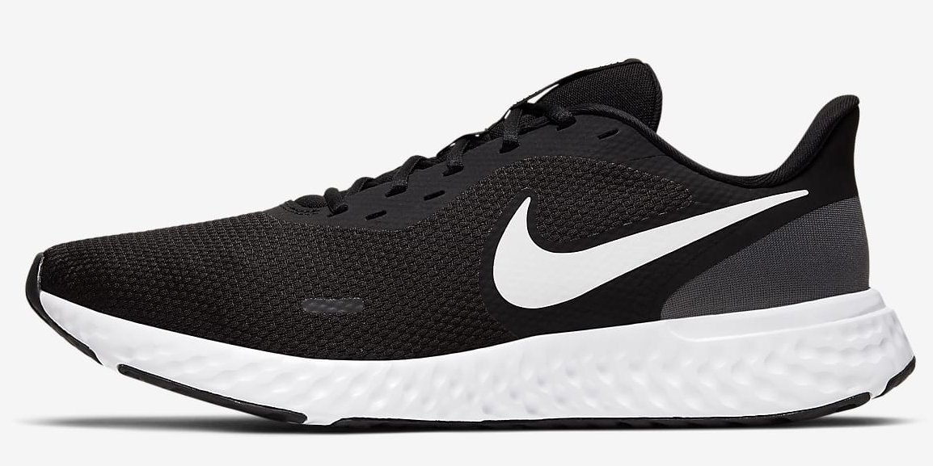
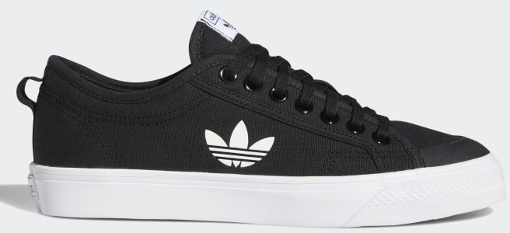
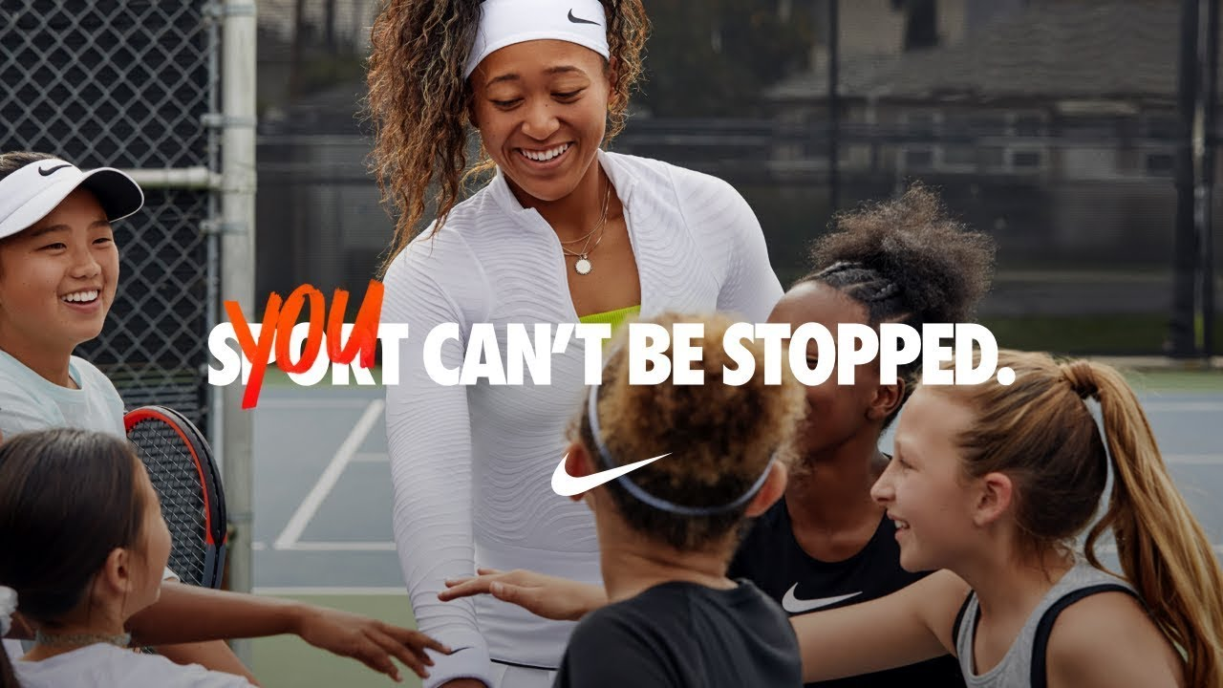
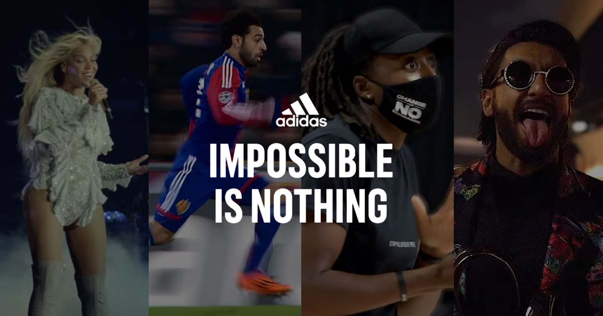
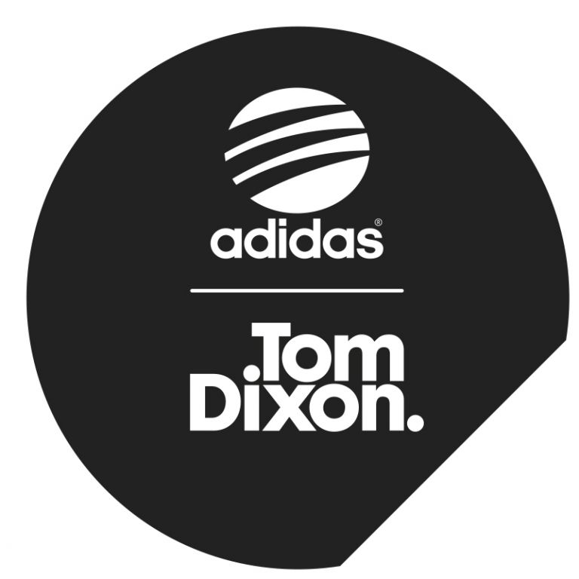

LOGOS ON PRODUCTS
Same logo for all products
Different logo based on product line
Notes:
As you can see, Nike has been using a consistent logo for all products while Adidas have different logos for different product lines.

Slide 6
Similarities: Perceived Quality
Consumer Imagery
Perceived Quality
Extrinsic: Brand Image
Nike & Adidas are well-established brand with a good brand image
Negative Brand Image
Positive Brand Image
Less likely to purchase product
More likely to purchase product
Notes:
Nike and Adidas are both well-established brands with a good brand image. Hence, if the consumer recognizes the nike or adidas logo on the product and they are able to associate it to the brand they are more likely to purchase the product if they have a positive impression of the brand

Slide 7
Similarities: Repetition
Long-Term Memory
Repetition
Same logo throughout
More Consistency
Very Effective Repetition
Benefits
Strong Brand Identity
Notes:
Both nike and adidas used long term reptition to promote their logo. Since nike uses the same logo for all their products, it is more consistent, so the repetition is effective as people are able to easily associate its logo to the brand. Hence, this leads to a strong brand identity

Slide 8
Similarities: Repetition
Long-Term Memory
Repetition
Different logo based on product line
Less Consistent
Less Effective Repetition
Consequence
Able to differentiate each subsidiary
Weak Brand Identity
Notes:
On the other hand, adidas uses different logo based on the product line which is less consistent. Hence the repetition is less effective. Although people are able to differentiate each product line the brand identity is weaker

Slide 9
Similarities: Experiential Hierarchy
Experiential Hierarchy
Affect → Behavior → Belief
Recognize logo
More likely to spontaneously buy product as they have previous positive experience using the brands’ product
Only 1 logo
Easier to recall & associate logo to brand
Multiple logos
May not recognize lesser-known logos
Notes:
Next, based on experiential hierarchy if people are able to identify the logo, they are more likely to spontaneously buy the product especially if they have a previous positive experience of using a product form the brand. As Nike only has 1 logo it easier to recall and associate to the brand but Adidas has multiple logos and people may not recognize the lesser-known logos.

Slide 10
Differences: Classical Conditioning
Classical Conditioning
Stimulus Generalization
Classical Conditioning
Stimulus Discrimination
Same logo for all products & marketing efforts
Different logo for based on product line
VS
Family Branding Strategy
Create new identity for each product line
Consumers’ positive feelings about the original brand will transfer to the new products in the product line extension
Consumers’ feelings about original brand will not affect their perception to the other product line
Notes:
Next based on classical conditioning, nike used stimulus generalization by using the same logo for all their products and marketing efforts. Hence, they adopted a family branding strategy so that consumers’ positive feelings about the original brand will transfer to the new products in the product line extension.
However, Adidas used stimulus discrimination as they used different logo based on the product line. They created a new identity for each product line so that consumers’ feelings about the original brand will not affect their perception on the other product lines

Slide 11
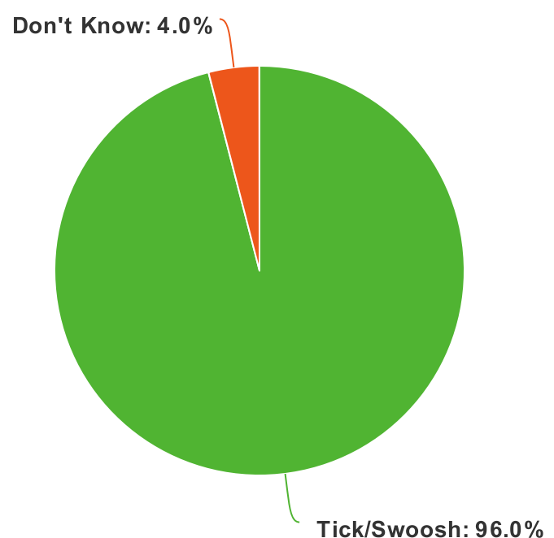
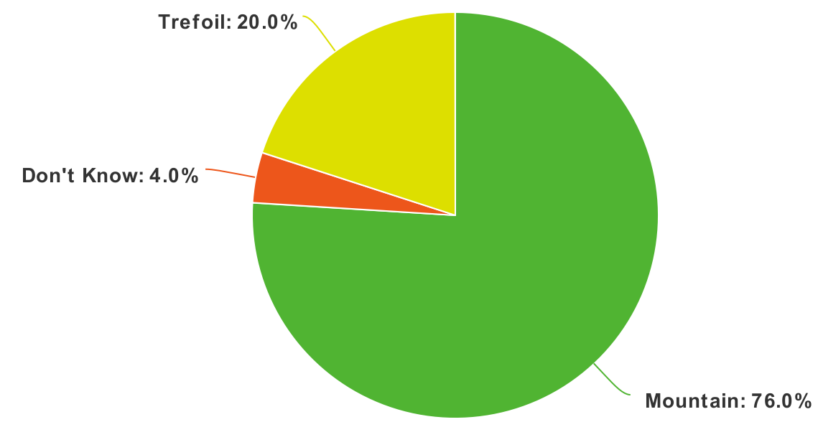
SURVEY RESULTS
50 Respondents
Without checking online, describe Nikes’/ Adidas’ logo
Notes:
Based on our survey which had 50 responses, 96% were able to describe Nike’s logo without checking online. As for Adidas, our respondents were able to recall only 2 logos which are the trefoil and mountain with 76% of respondents describing the mountain

Slide 12
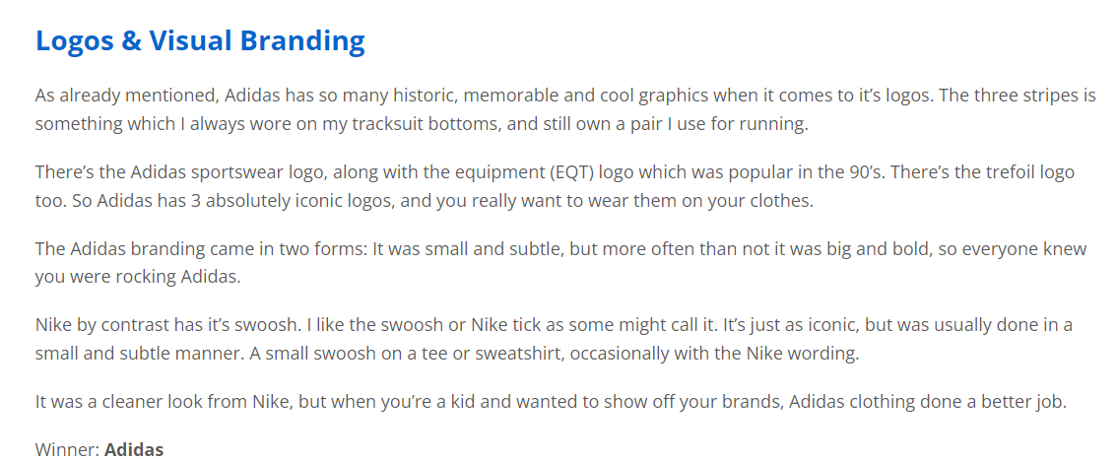
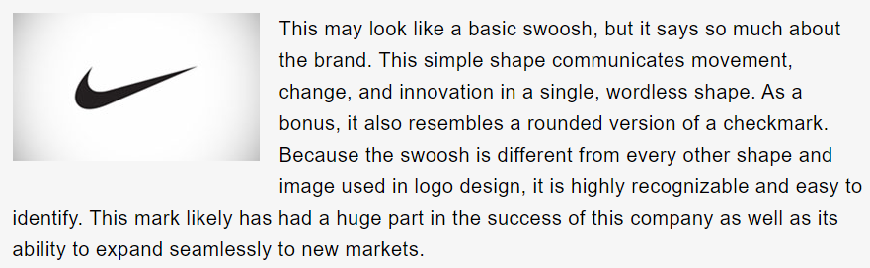

Logo Effectiveness
Adidas more effective than Nike due to creation of multiple iconic logos
https://www.michael84.co.uk/adidas-vs-nike-which-is-the-best-heres-everything-you-need-to-know/
Nike logo is very recognizable & iconic
Use of multiple logos can be confusing especially for non-fans
https://www.spellbrand.com/top-10-simple-logos-yet-effective-logos
https://eachshoes.com/what-do-the-differences-between-adidas-logo-templates-mean/
Notes:
Online articles suggest that Adidas is more effective than Nike due to the creation of multiple iconic logos. However, most articles agreed that nike’s logo is also very recognizable and iconic as well. A few articles highlighted that since Adidas has many logos, it can be confusing especially for non-fans

Slide 13
02
COLLABORATION
Nike VS Adidas
Notes:
The second comparison would be on a collaboration Nike and Adidas have done

Slide 14
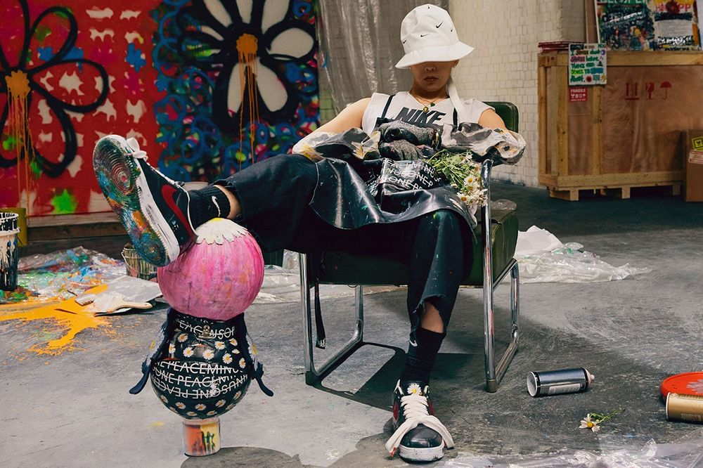
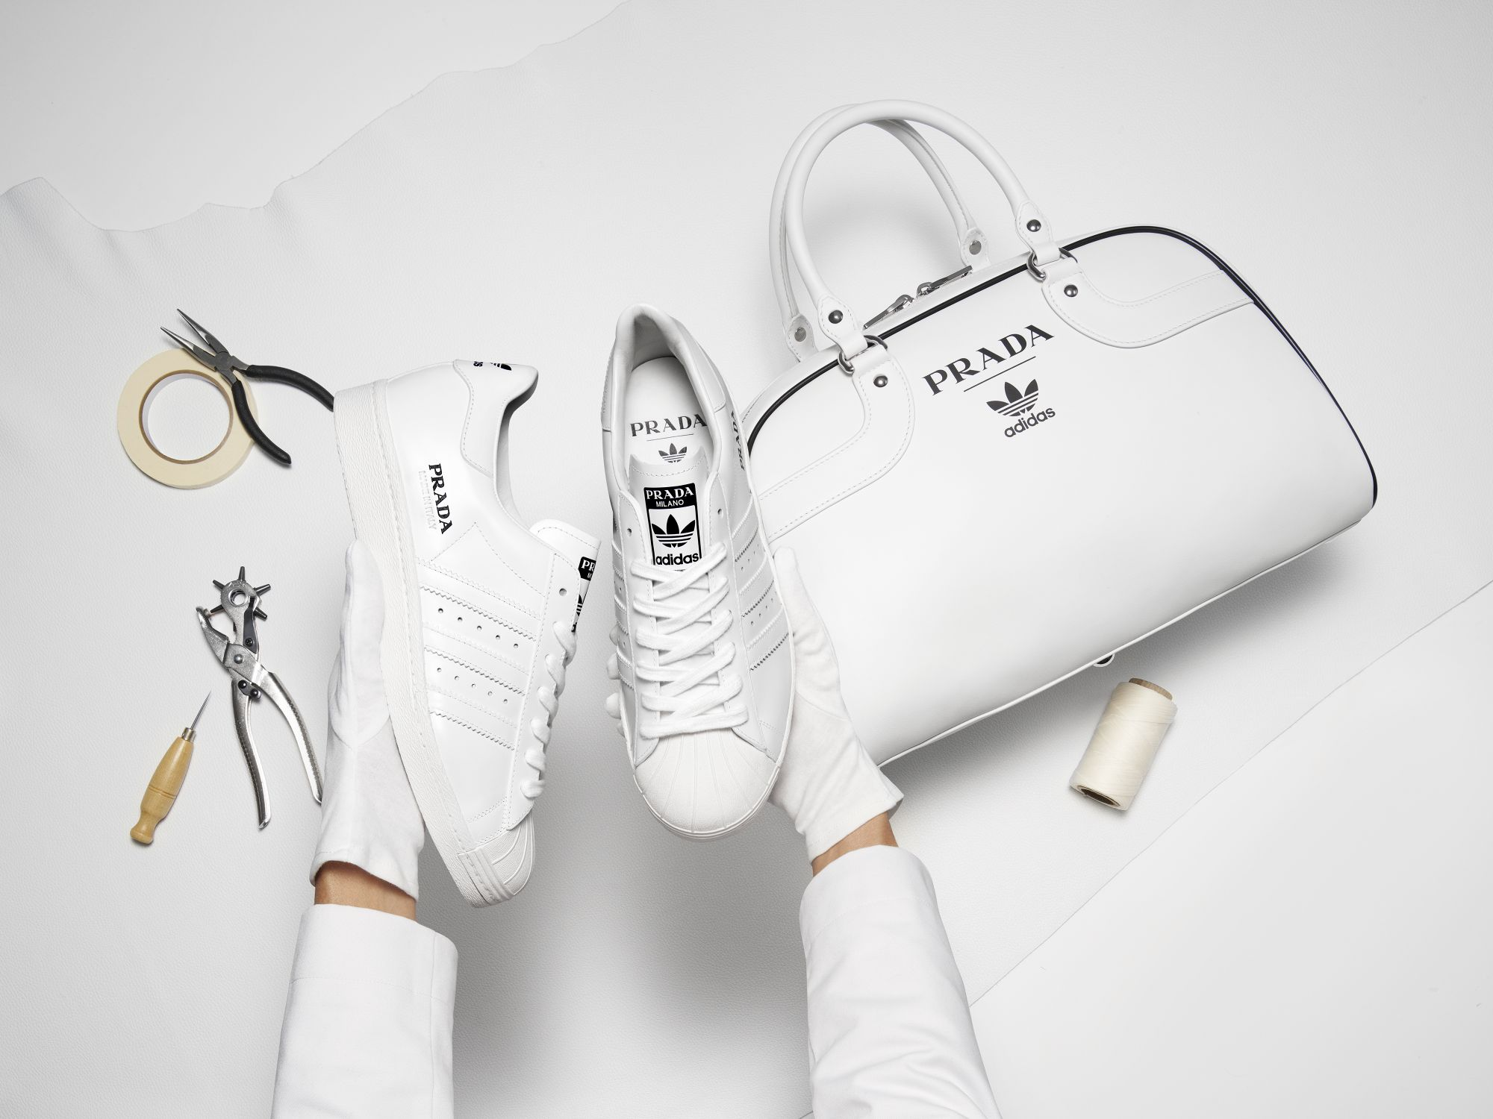
COLLABORATION
Nike X G-Dragon
Adidas X Prada
Air Force 1 Paranoise
Prada Superstar
Nike collaborated with a popular K-pop idol, G-Dragon to release “Nike Air Force 1 Paranoise”. The shoes features a black painted overlay designed to slowly wear away overtime to reveal a personal artwork created by G-Dragon.
Adidas collaborated with Prada to release, “Prada Superstar”. The shoes are designer sneakers which were made in Italy. The shoes were carefully crafted by footwear specialists using high quality materials. This collaboration is an twist on the existing Adidas Superstar model
Notes:
Nike collaborated with a popular Kpop idol, G-dragon to release Nike Air force 1 paranoise while Adidas collaborated with Prada to create parda superstar which is a high-end version of the original adidas superstar model

Slide 15
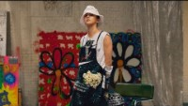

Promotional Video
Nike X G-Dragon
Adidas X Prada
Prada Superstar
Air Force 1 Paranoise
PRADA SUPERSTAR
Notes:
Both Nike and Adidas released a promotional video for this collaboration. Nike’s video featured G-Dragon while Adidas’ video showed the small-scale version of the process in which the shoe was manufactured

Slide 16
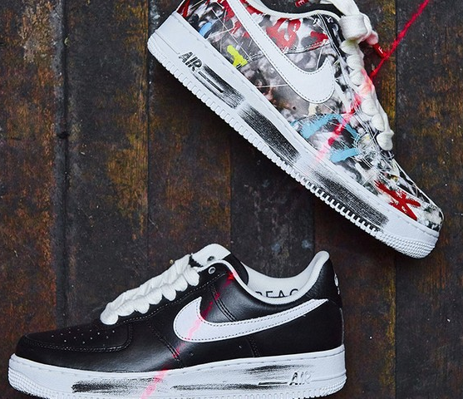
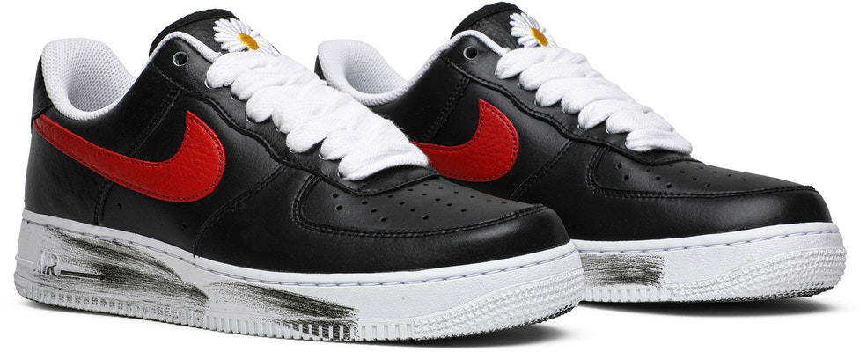
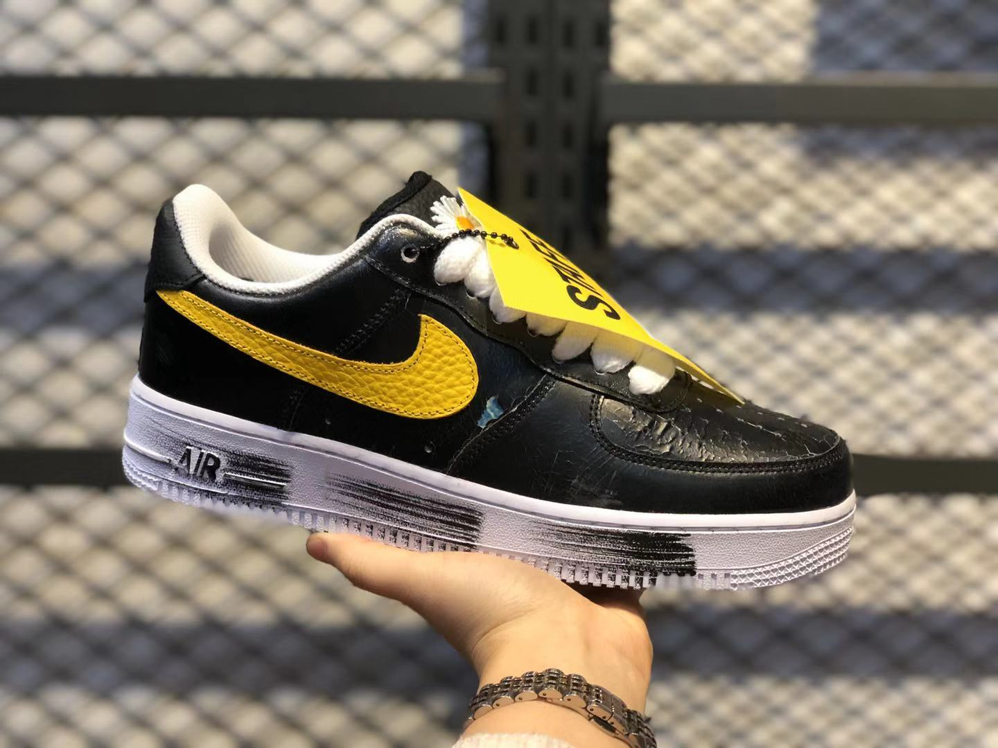
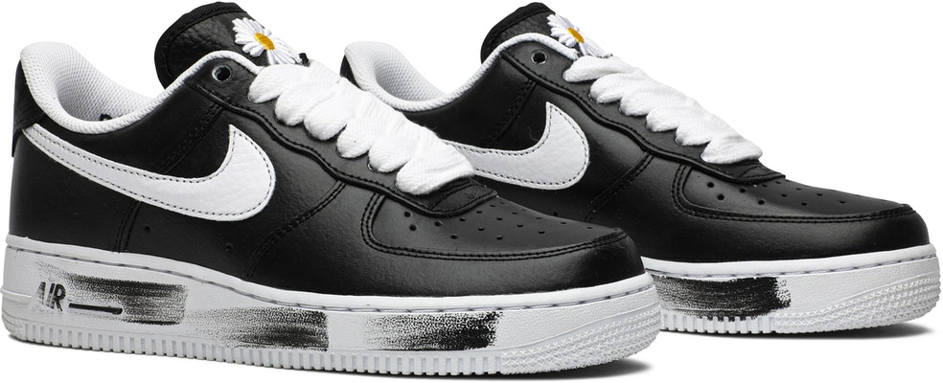
Nike X Gdragon
3 versions
White Swoosh – Global Exclusive
Red Swoosh – Korea Exclusive
Yellow Swoosh – Staff & Friends Exclusive
Black Covering VS
G-Dragons’ Personal Artwork Below
Notes:
In the nike’s collaboration, the shoes features a black painted overlay designed to slowly wear away overtime to reveal a personal artwork created by G-Dragon.
There are 3 versions of the shoes and all 3 of them are limited edition

Slide 17
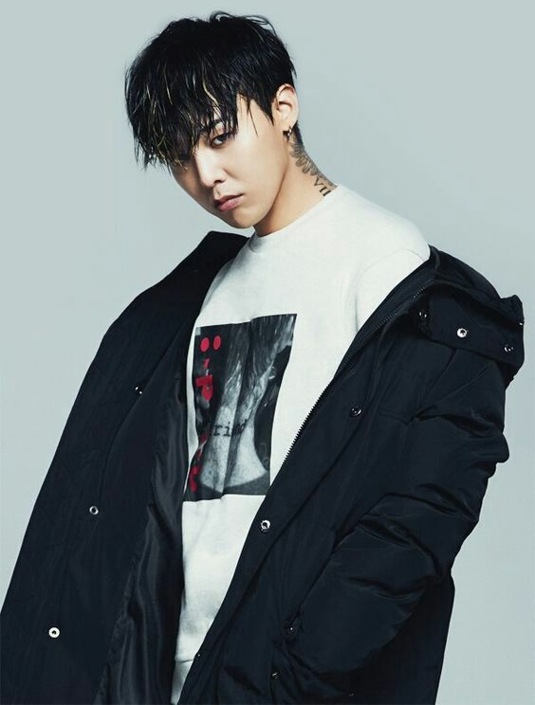
Differences: Use of Celebrity
Source Characteristics
Attractiveness
Popular K-pop Idol
    High social status
    Attractive
Message Source Factors
Likeability
Attractiveness
Large global fan base
Henry Murray Psychogenic Needs
Needs Associated with inanimate objects: Acquisition
VALS
Experiences: young, impulsive, enthusiastic
Emotionally Involved
with G-Dragon
Experiential Hierarchy
Affect → Behavior → Belief
AND/OR
Persuasion
Liking: They like/admire him
Notes:
Firstly, Nike leveraged the source characteristic, attractiveness as G-Dragon is a popular and attractive kpop idol with high social status. Hence, by using him, Nike increased the likeability and attractiveness of their collaboration. Thus, his fans worldwide are persuaded to buy the shoes as they admire and like him. Some may even feel emotionally involved with him. So, these people are more likely to spontaneously buy the shoes as they want to support his collaboration. This especially can be seen in experiences whoa are young and impulsive. They acquire these shoes as they want to satisfy their needs associated with inanimate objects.

Slide 18
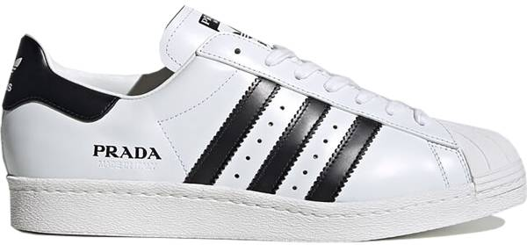
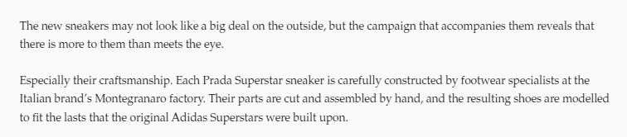
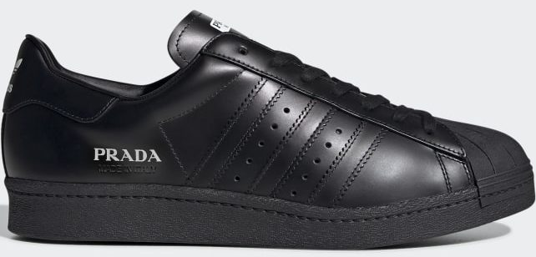
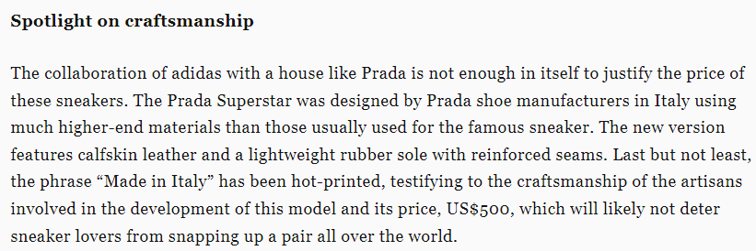
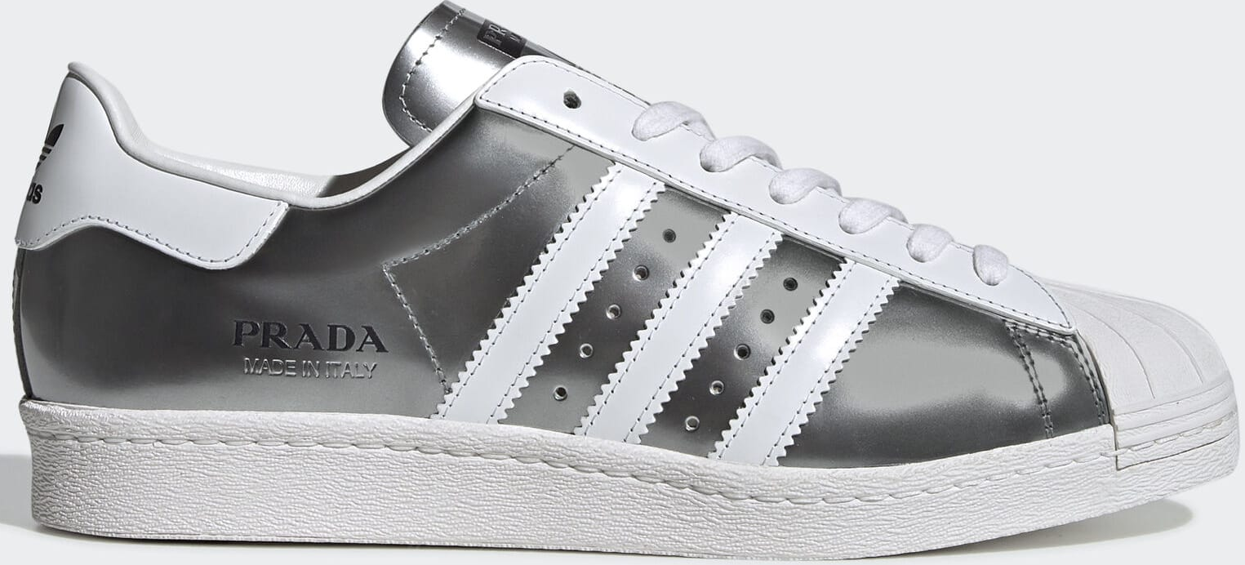
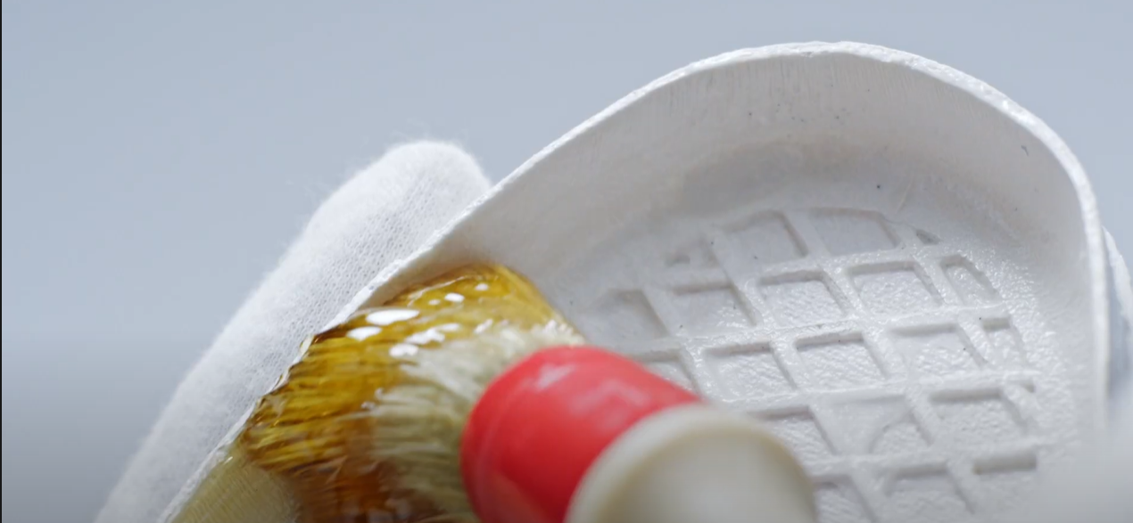
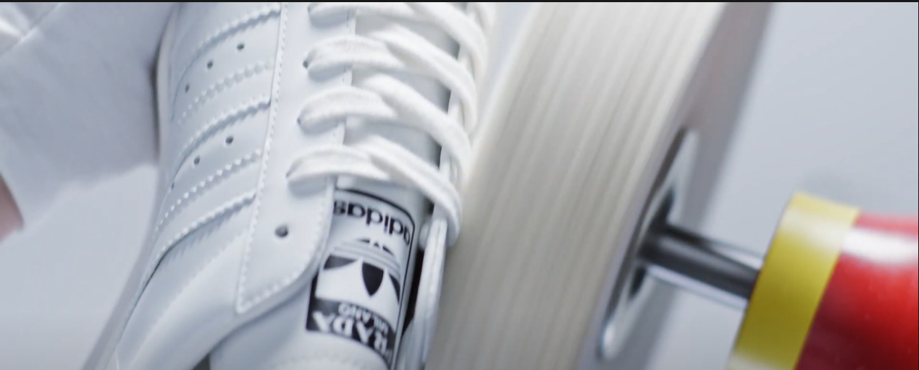
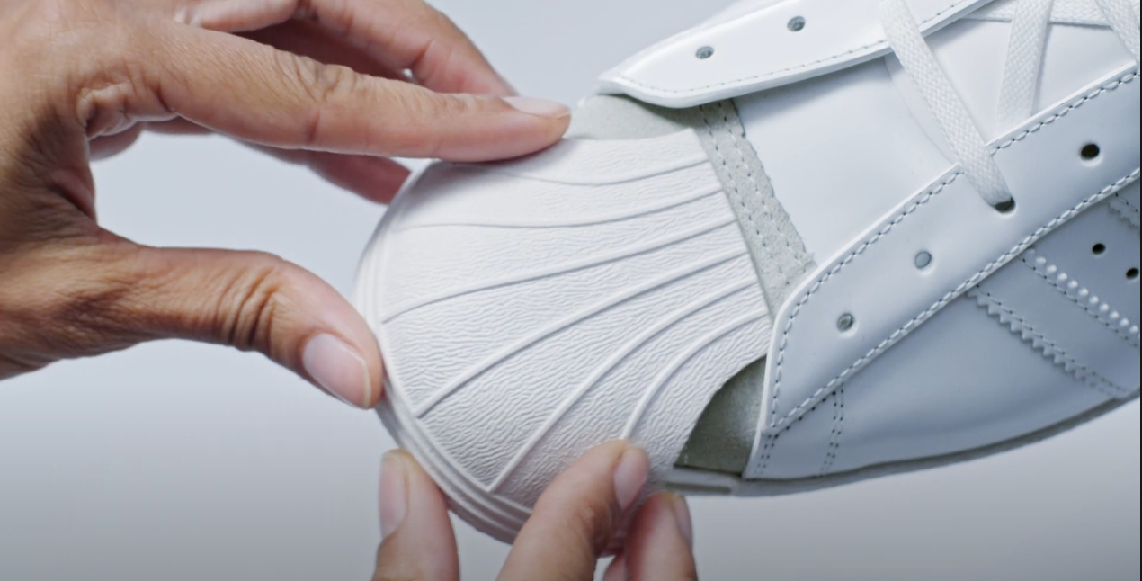
PRADA X ADIDAS
3 versions
Black & White
Black
Chromed Silver & White
Emphasis on high-quality materials used & skillful craftmanship through articles & promotional video
Notes:
The marketing efforts for the prada and adidas collaboration emphasized the high-quality materials used and the skillful craftmanship used to create the shoes

Slide 19
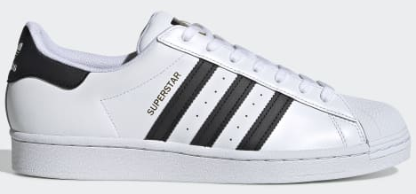
Differences: Perceived Quality
Consumer Imagery
Perceived Quality
Brand Quality Partner
Both Prada & Adidas are perceived to be brands which produce high quality products
Video & articles highlight skillful craftmanship & high quality of materials used to shoes
Extrinsic: Consumers develop trust for the shoes due to the positive image of brands
Adidas Superstar is also an existing popular shoe model. Hence, consumers may have prior positive experience with that model
Intrinsic: Positive impression on good quality of shoes
More likely to buy the shoes
Notes:
Hence, the consumers have a positive impression on the quality of the shoes. Adidas and Prada are also brands perceived to produce high quality products. So consumers develop trust for the shoes due to the positive image of the brands. Also, this collaboration is a twist on the existing popular adidas superstar model. Hence, consumers who have previously have a positive experience with the brands or the superstar model are more likely to buy the shoes.

Slide 20
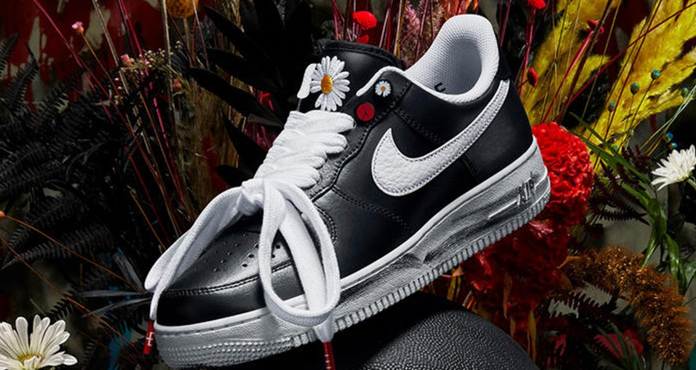
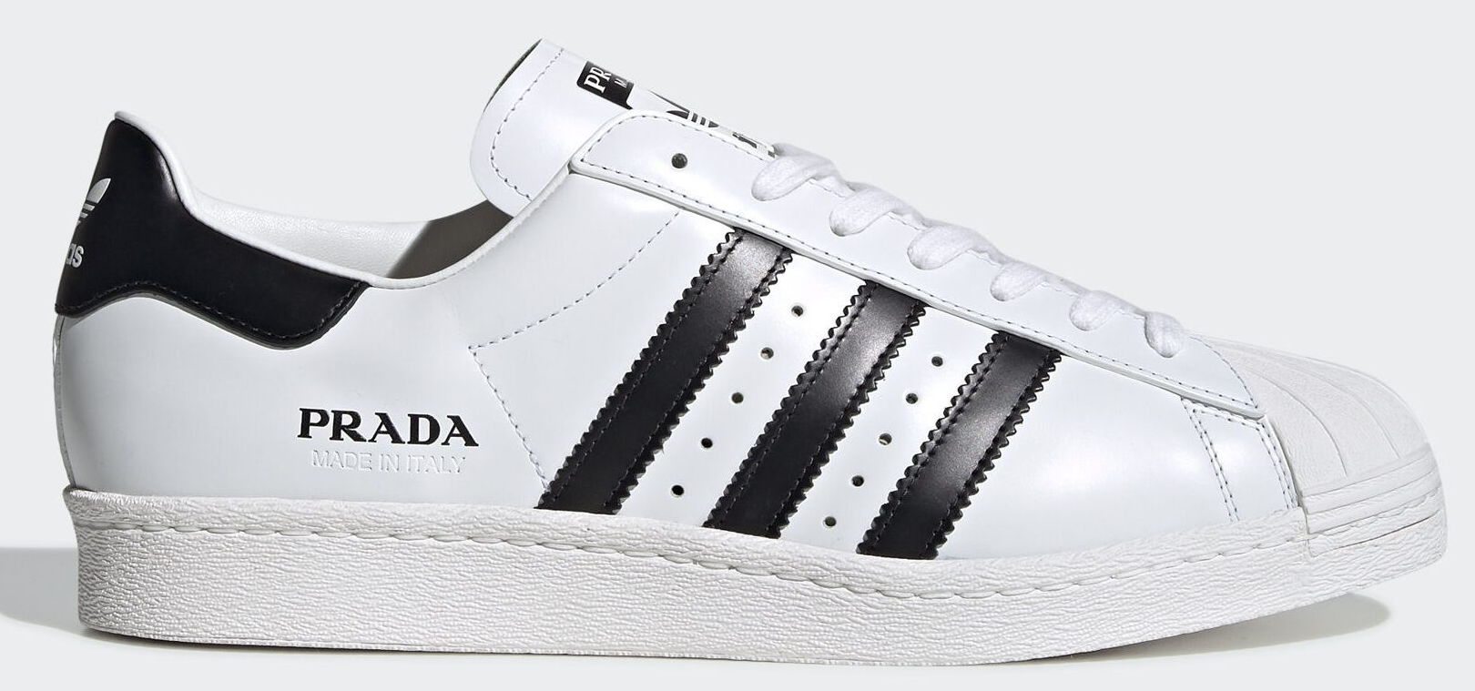
Similarities: Limited Edition
Approaches to Persuasion
Scarcity
Limited supply
Emotional Appeal
Fear of Missing Out
Yellow Swoosh – 88 pairs
Red Swoosh – 818 Pairs
White Swoosh – Unknown but limited
700 Pairs
Experiential Hierarchy
Affect → Behavior → Belief
VALS
Experiences: young, impulsive, enthusiastic
Notes:
The similarity between the two collaboration is that there are limited pairs of shoes available. The limited supply appeals to peoples’ fear of missing out. Hence, according to experiential hierarchy they spontaneously buy the shoes as they don’t want to lose the chance. As mentioned previously, experiences are more likely to buy this due to impulsiveness.

Slide 21
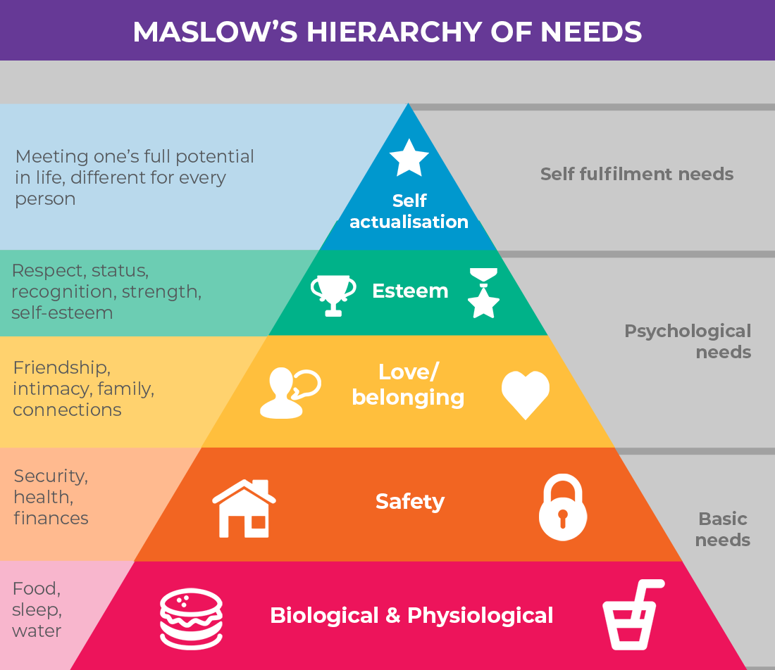
Similarities: Limited Edition
Traits in Consumer Behavior
AND/OR
AND/OR
Competitiveness
}
Materialism
Self-Concept:
Ideal social self
Boost
Self Esteem
Hedonic Motivation
VALS
Strivers
Demonstrate ability to get limited edition products
Notes:
In addition, consumers who are competitive or materialistic are more likely to buy the shoes to satisfy their hedonic motivation as they feel gratified when they manage to buy limited edition products which are expensive and difficult to get their hands on. Hence, they are also likely to be strivers. Moreover, these consumers who want to buy limited edition products want to be viewed as successful or wealthy or they would like to boost their self esteem with high end products. Therefore, based on the Maslow hierarchy of needs, these consumers would buy the shoes to satisfy their esteem as they care about their social status and their self esteem.

Slide 22
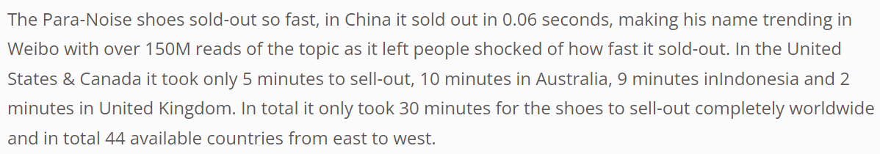
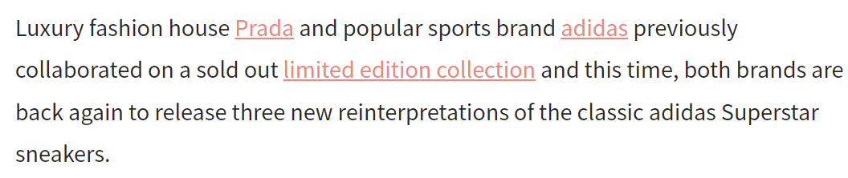


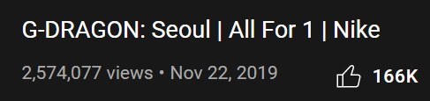
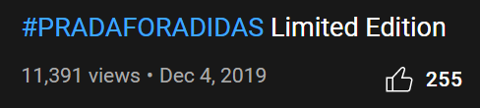
Collaboration Effectiveness
Nike X G-Dragon
Adidas X Prada
Both shoes sold out
Follow up Collaboration
Nike has more YouTube Viess than Adidas
Notes:
Both collaborations were successful as the shoes were sold out and both had a followup collaboration. However, Nike had more YouTube views for their collaboration as it featured G-Dragon compared to Adidas.

Slide 23
03
ENVIRONMENTALLY-FRIENDLY SHOES
Nike VS Adidas
Notes:
Thank you Varsha, now I will be sharing about the environmentally-friendly shoes both nike and adidas launched

Slide 24
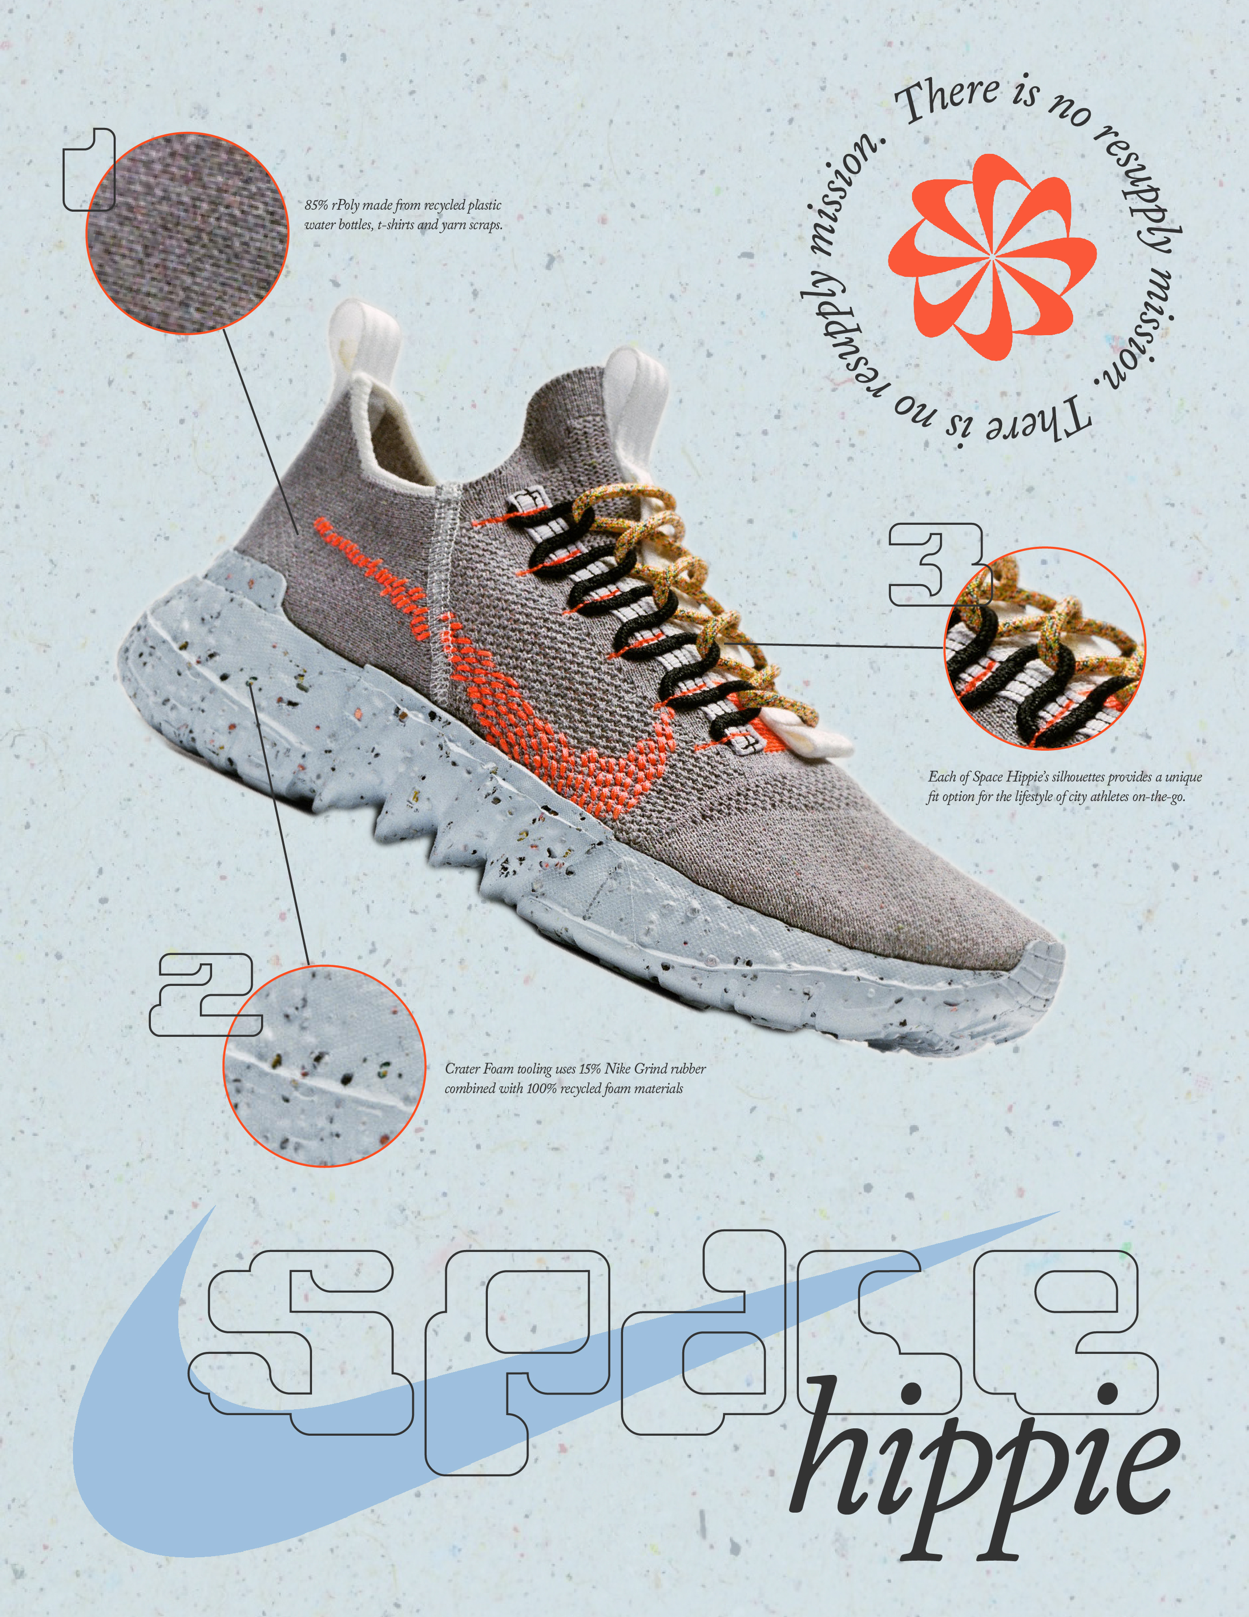

Stan Smith, Forever
Nike Space Hippie
Environmentally-Friendly Shoes
Nike had launched a new brand of shoes which are made out of multiple types of recycled materials for their move to zero campaign where the central theme of the shoes was about recycling in space.
To support Adidas’ “End Plastic Waste” campaign, launched “Stan Smith, Forever” which is an eco-friendly version of the STAN SMITH SS21 model which has been a classic silhouette.
Notes:
We will be looking at Nike’s Space hippie collection and Adidas’s remastered stan smith collection. Nike had created a line of shoes based on the concept of recycling in space, while adidas had redesigned its famous stan smith collection to include recycled materials in its shoe material.

Slide 25


Promotional Videos
Stan Smith, Forever
Nike Space Hippie
This promotional video shows Nike Executives and staff talking about their idea, vision and goals for the Space Hippie and make Nike a more environmentally sustainable company. It also showed the process of creating the eco-friendly shoe.
This video takes an motivational approach to talk about being green and doing our part to make the world a greener place. It features many celebrities.
Notes:
Both brands released a promotional video to promote the launch of the shoes

Slide 26
Similarities: Eco-Friendly Shoes
Functions of Attitudes
Value Expressive Function
Eco-Friendly Shoes
Self-Concept
Actual Self: Sustainable person
OR
Self-Concept
Ideal Self: Sustainable Person
Self-Congruency Theory
Purchasing an eco-friendly shoes aligns with their self-concept
Maslow Hierarchy of Needs
Self-Actualization
Notes:
Both brands made use of the value expressive function as the eco-friendly shoes could express the consumers ideal or actual self concept of being an environmentally sustainable person. Hence, based on the self-congruency theory, purchasing the eco-friendly shoes aligns with their self concept. Moreover, it helps fulfil their self actualization needs of becoming a sustainable person

Slide 27
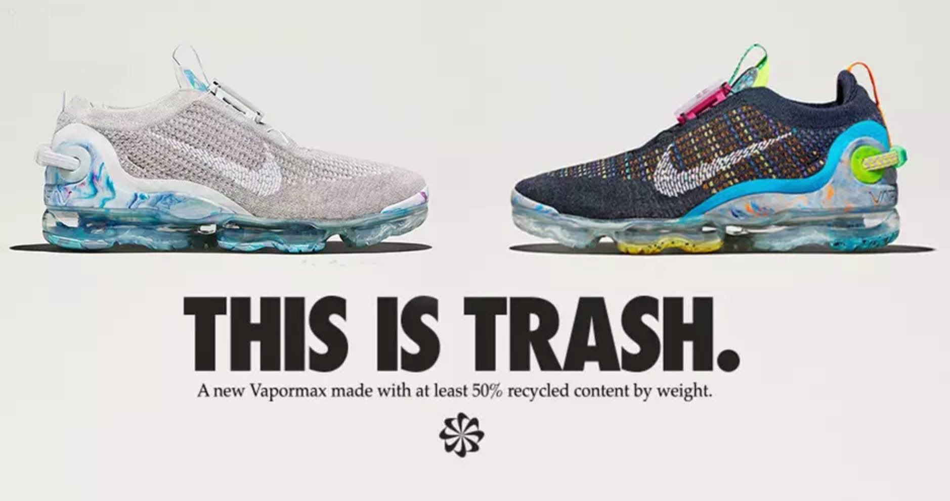
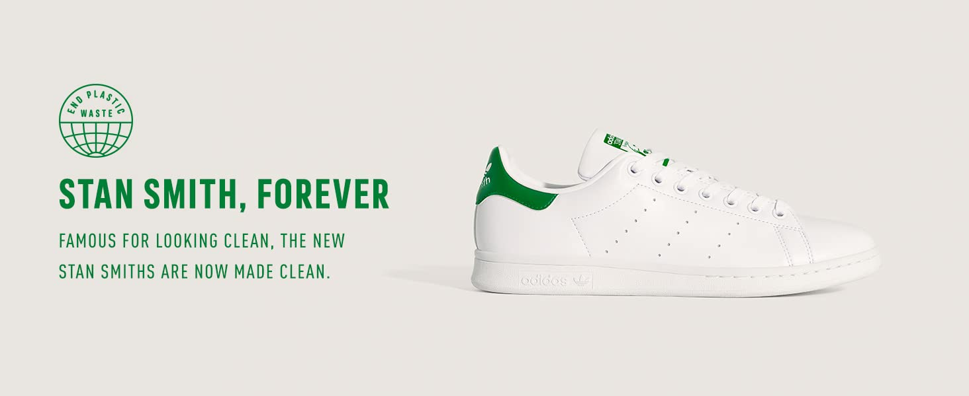
Similarities: Physical Characteristic of Message
Intensity
“THIS IS TRASH” / “STAN SMITH, FOREVER”
Capitalized letters
Large font size
Bolded
Easy to read and captures attention of consumers immediately
Font
Colour
Black- easy to read but boring
Green – Relate to shoe’s colour & represents the colour of the environment which is perceived as green
Notes:
Both brands also released posters to promote their product. Both nike and adidas used

Slide 28
Similarities: Environmental Characteristic of Message
Information Intensity
Short and simple messages
Increases attention & comprehension
Easier to understand & react

Slide 29
Differences: Message source, message, persuasion
Source Characteristics
Credibility
Source Characteristics
Attractiveness
Video featured executives and staffs and documented the process of coming up with the idea to the production of the final product
Video featured Stan Smith, Kermit the Frog, skaters Na-Kel Smith and Nora Vasconcellos as well as actress Yara Shahidi.
VS
Message Source Factors
Attractiveness & Likeability
Message Source Factors
Expertise
Persuasion
Authority
Persuasion
Liking
Notes:
Firstly, Nike leveraged the source characteristic, credibility by featuring Nike executives who talked about the shoes and also showed the production process of the shoes. Since they used experts to promote the shoes, its more credible and people are persuaded by the authority of these executives to purchase the product.
Adidas leverage the source characteristic attractiveness by attractiveness by involving Stan smith, Kermit the frog, athletes and an actress who all have high social status. Hence, by using them, Nike increased the likeability and attractiveness of their shoes. Thus, his fans worldwide are persuaded to buy the shoes as they admire and like them.

Slide 30
Differences: Major Trait
Major Traits
Innovativeness
Major Traits
Need for cognition
Nike came up with a new idea to create shoes using trash
Nike documented the process of producing the shoes and Nike staff who talked about the shoes
Experiential Hierarchy
Affect → Behavior → Belief
Fresh & innovative idea that has not been done before
Consumers will be engaged by information from the video
VALS
Experiences: young, impulsive, enthusiastic
Consumer with major trait of “Innovativeness” more likely to be open to this idea & buy the shoes to try it out
Think carefully and logically about what they said & considers it before buying shoes
Notes:
Hence, the consumers have a positive impression on the quality of the shoes. Adidas and Prada are also brands perceived to produce high quality products. So consumers develop trust for the shoes due to the positive image of the brands. Also, this collaboration is a twist on the existing popular adidas superstar model. Hence, consumers who have previously have a positive experience with the brands or the superstar model are more likely to buy the shoes.

Slide 31
Differences: Major Trait
Experiential Hierarchy
Ins
Major Traits
Need for cognition
Nike came up with a new idea to create shoes using trash
Nike documented the process of producing the shoes and Nike staff who talked about the shoes
Experiential Hierarchy
Affect → Behavior → Belief
Fresh & innovative idea that has not been done before
Consumers will be engaged by information from the video
VALS
Experiences: young, impulsive, enthusiastic
Consumer with major trait of “Innovativeness” more likely to be open to this idea & buy the shoes to try it out
Think carefully and logically about what they said & considers it before buying shoes
Notes:
Hence, the consumers have a positive impression on the quality of the shoes. Adidas and Prada are also brands perceived to produce high quality products. So consumers develop trust for the shoes due to the positive image of the brands. Also, this collaboration is a twist on the existing popular adidas superstar model. Hence, consumers who have previously have a positive experience with the brands or the superstar model are more likely to buy the shoes.

Slide 32
Differences: Perceived Quality
Consumer Imagery
Perceived Quality
Extrinsic: Product Image
The Stan Smith model is a well-established and iconic model.
It has been around for many years
Consumers will be more trusting & receptive to the eco-friendly version
More likely to purchase product
*Nike launched a new line of shoes instead
Notes:
Hence, the consumers have a positive impression on the quality of the shoes. Adidas and Prada are also brands perceived to produce high quality products. So consumers develop trust for the shoes due to the positive image of the brands. Also, this collaboration is a twist on the existing popular adidas superstar model. Hence, consumers who have previously have a positive experience with the brands or the superstar model are more likely to buy the shoes.

Slide 33
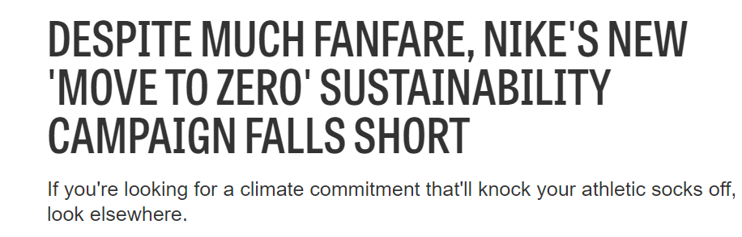
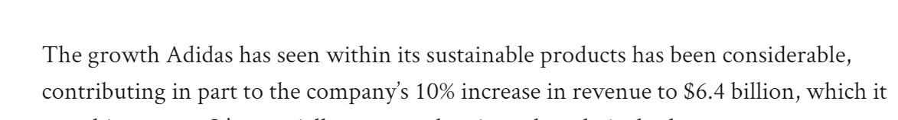
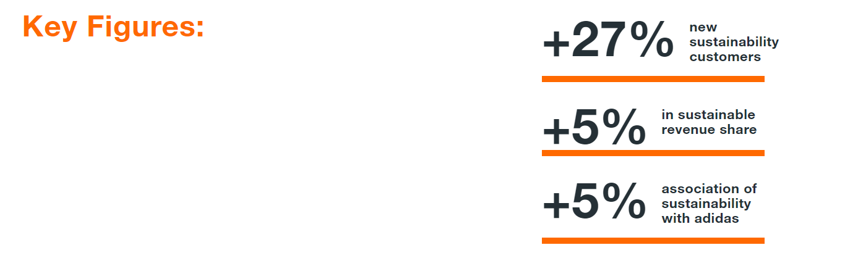
Effectiveness
1 Million Views
21 Million Views
30k Likes
2.2k Likes

Slide 34
04
Women Empowerment
Nike VS Adidas

Slide 35
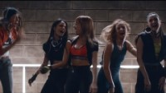

Nike “This is us”
Women Empowerment
Adidas “Watch us move”
Nike ‘This is us’ is a sub-campaign of a larger female empowerment campaign focused on breaking the stereotypes of women in society. It aims to break through stereotypes and create a free and open space for women to pursue their passion in sports
Adidas “Watch us move” is a campaign focused on creating an inclusive space for ALL women in society regardless of their race, nationality or body type.
The campaign promotes the #Formotion​ collection of apparel, which is designed for women to allow for freedom of movement and cater for the fact that women's bodies are each unique.
Notes:
For my second examples, we will be looking at Nike’s “This is us” campaign and Adidas’s ”Watch us move”. Nike’s campaign’s focus was to empower women by showing them breaking traditional stereotypes while also promoting their female sportswear. Adidas’s campaign was also focused on empowering women by showing them enjoying active activities and working out while also promoting their new line of female sportswear

Slide 36
Similarities: Maslow Hierarchy of Needs
Maslow Hierarchy of Needs
Self Actualization
Empowers women to break through stereotypes and create a free and open space for women to pursue their passion for sports
Empowers women all women to be who they are regardless of their race, nationality or body type.
Emotional Intelligence
Identified issues women face and motivates them to disregard stereotypes or social normal and be confident about themselves.
Emotional Involvement
Boosts women’s self esteem and causes them to be emotionally involved with the campaign since they can relate to it and feel empowered by it

Slide 37
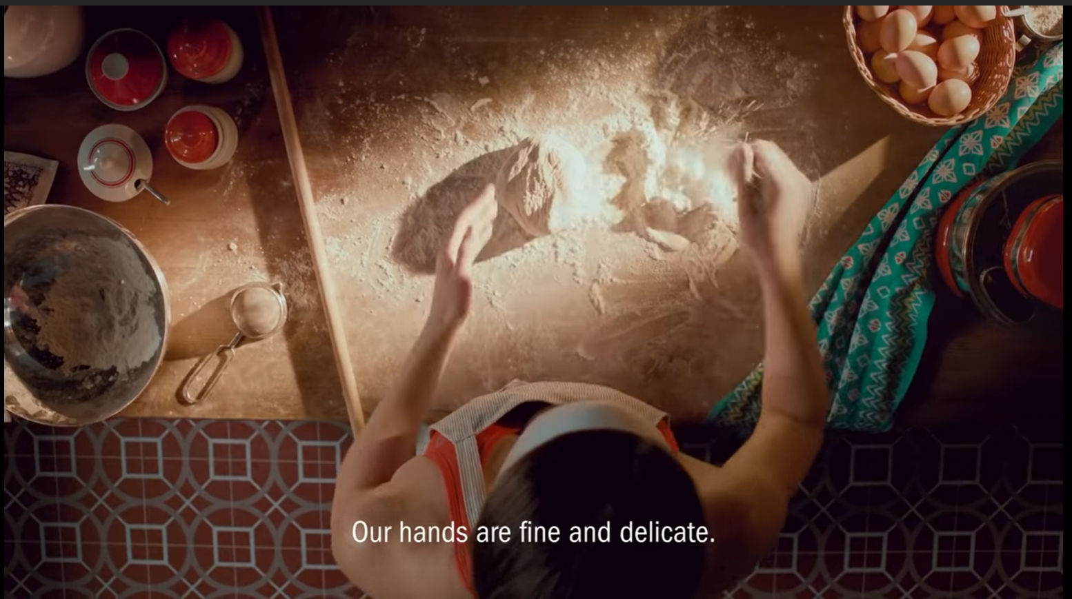
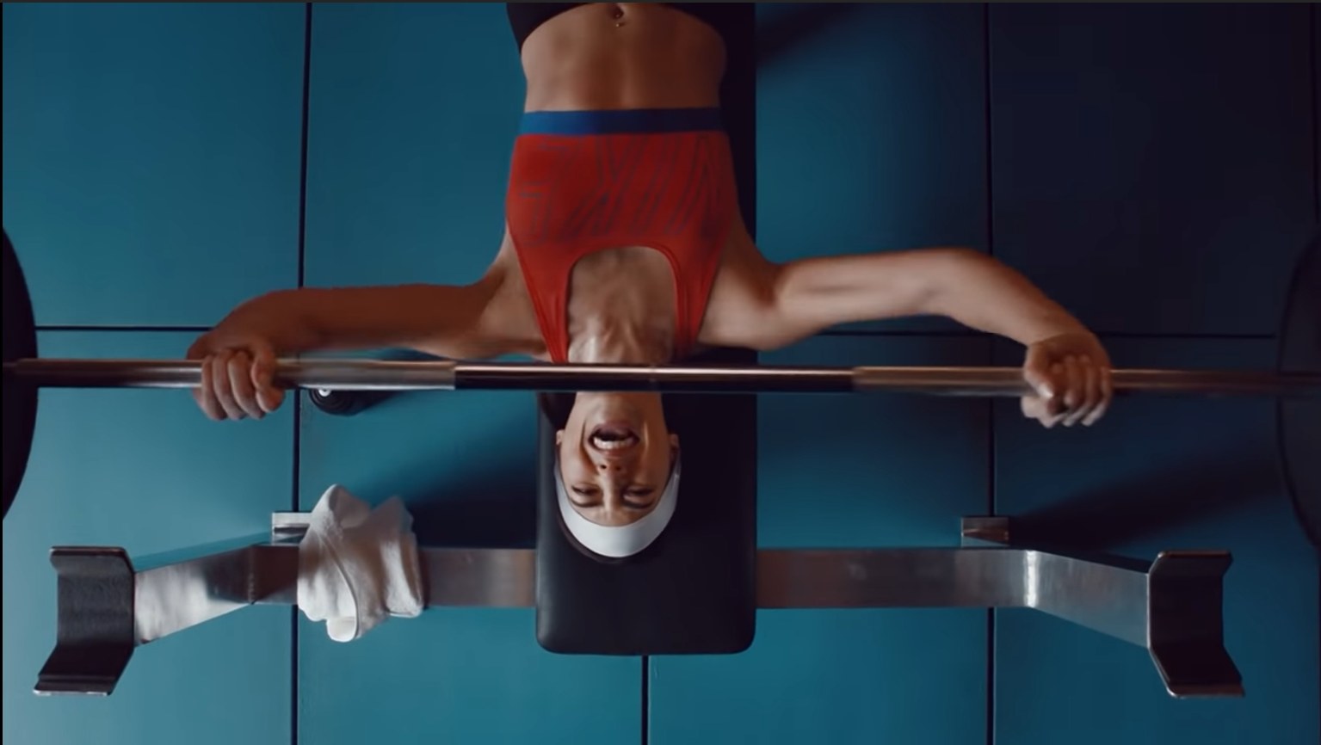
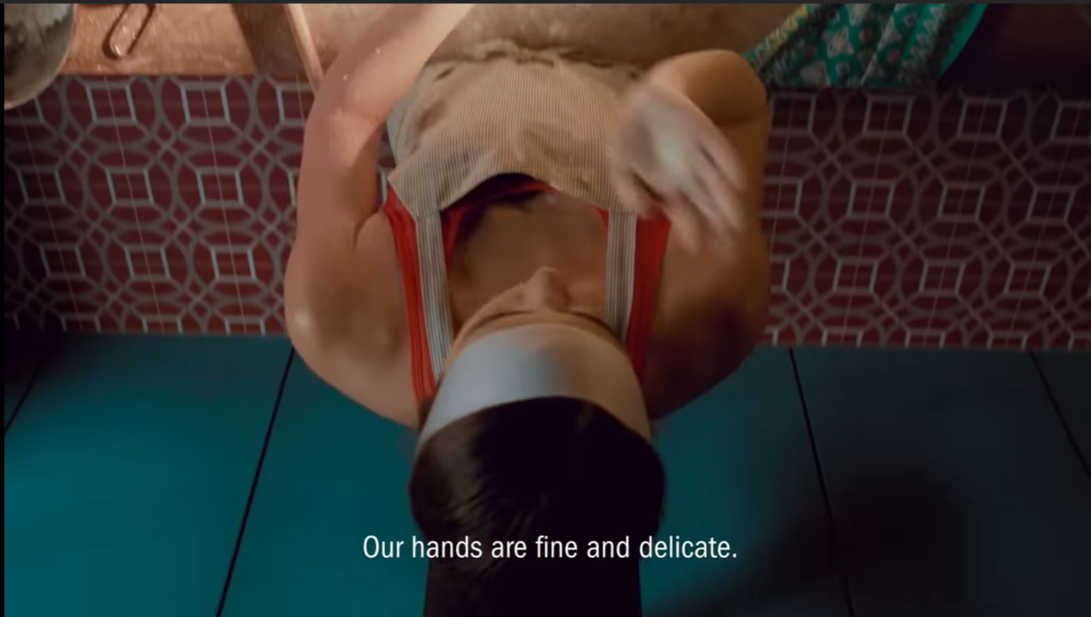
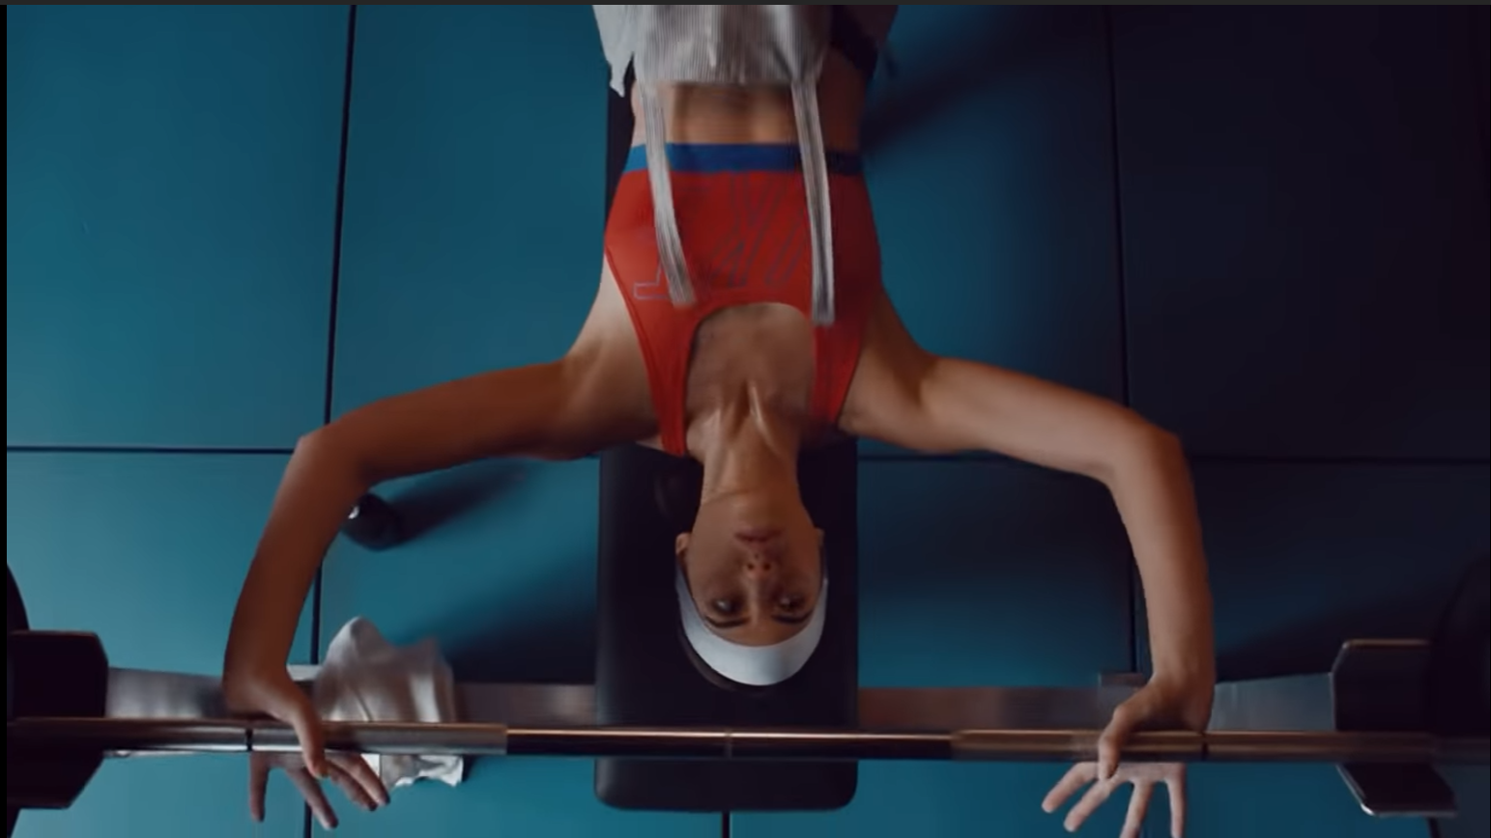
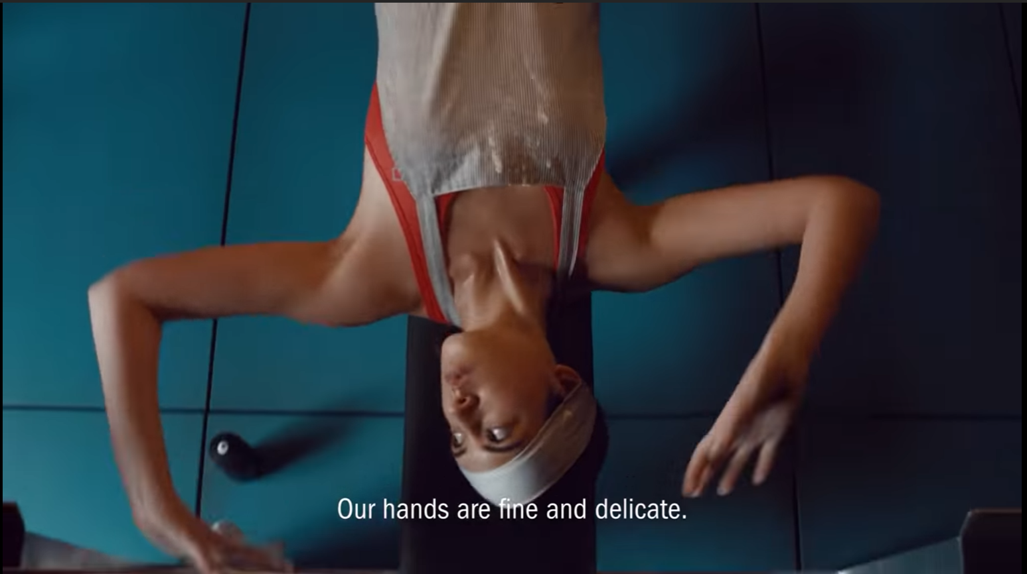
Factors affecting Consumer comprehension -Physical Characteristics
Smooth transition
From traditional female role to their confident and strong character when pursing sports
Notes:
Camera movement brings out a Smooth transition From traditional female role where they wear an apron and is found in the kitchen to their confident and strong character when pursing sports where they wear a sportwear and is weightlighting

Slide 38
Factors affecting Consumer comprehension -Message
Voiceover represents stereotype while the ending visuals represent how women can break stereotypes and perceived social norms
Proving Against Social norms: Our hands can also be used to do weight-lifting. It isn’t a must to be have fine and delicate hands for women
Stereotype: “Our hands are fine and delicate”
Notes:
When their in their traditional female role, their will be a voice representing how female should be which is in this case their hands school be fine and delicate and be used for mild activities. They can only be found in the kitchen . However, as the screen transition. t

Slide 39

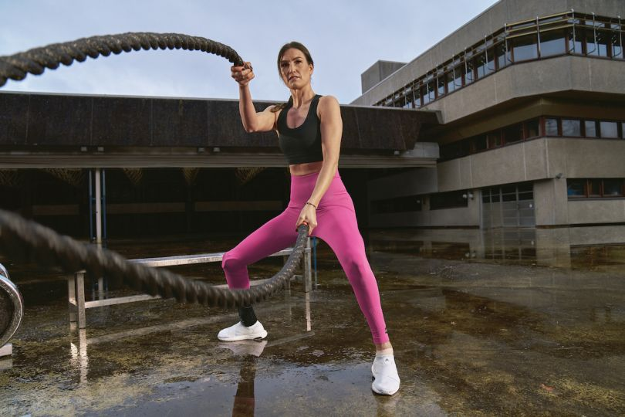
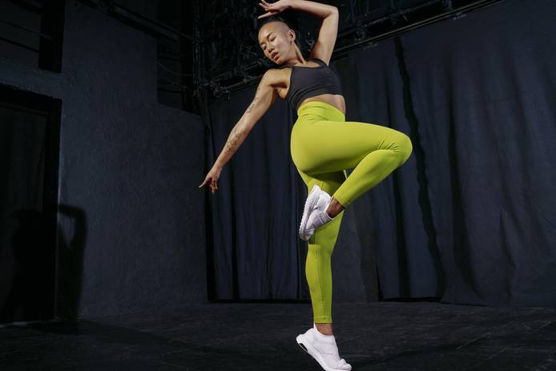


Factors affecting Consumer comprehension -Physical Characteristics
Recognizes the problem of how women feel uncomfortable when wearing sporting wear
Emphasizes video message- “I am able to be exactly who I am”
Encourage and empower women to not care about how people think of them and be who they want to be.
Showcase women of different body type being confident and happy when sporting
Promotes Body Positivity & Boost self-esteem
Notes:
Camera movement brings out a Smooth transition From traditional female role where they wear an apron and is found in the kitchen to their confident and strong character when pursing sports where they wear a sportwear and is weightlighting

Slide 40

Similarities: Message appeal → Emotional Involvement
“We have pretty faces”
“I am able to be exactly who I am on any given day”
“Our hands are fine and delicate’
“And I am able to stand in my truth no matter what’
“We’re always quiet and humble And we wouldn’t dare to laugh in public. Now would we?”
“Now watch us move”
“You know us don’t you?”
Utilizes “I” to represent how woman should be think of themselves. Invoke confidence and empower them
Uses rhetorical questioning and stereotypical message to invoke courage and confidence in women
Both invokes confidence and empower the women in their ways →Gives women courage to pursue what they like → Emotional involvement with campaign and brand

Slide 41
Factors affecting Consumer comprehension: Environment
“We have pretty faces”
“I am able to be exactly who I am on any given day”
“Our hands are fine and delicate’
“And I am able to stand in my truth no matter what’
“We’re always quiet and humble And we wouldn’t dare to laugh in public. Now would we?”
“Now watch us move”
“You know us don’t you?”
Both has Low Information Intensity
Around 3 to 4 messages in total for each video→ utilize more visual rather than words→ message less but impactful → increases audience’s attention, comprehension and eventual reaction→ easier to understand campaign message

Slide 42


Difference in consumer comprehension
Pursue what you like
Body Positivity
Nike video visuals and message focuses on more on how women are limited by traditional stereotypes and make everyone rethink about how society have changes and women can do whatever they like and want
Adidas video visual and message focuses on how women can be confident in their sports wear and bring out the best of themselves. It also emphasizes on body positivity and confidence
Notes:
Third, Nike successfully created a stronger and more impactful message than Adidas. The message states “When we’re held back, we will go farther and harder”. All messages follows the format of what is the current bad situation Vs how to overcome it. For instance when athletes are held back by the pandemic, where things don’t go in their way, they will find a way which is to carry out trainings at homes or booked areas. As for adidas message, there is no acknolegement of the current sitation, it just emphazies on how pwopl should be ready and prepared in the next comeback

Slide 43
 | Nike | Adidas
Visual | Smooth transition between traditional roles and sporting roles | Showcase women of different body type being confident and happy when sporting
Message | Uses rhetorical questioning and stereotypical message to invoke courage and confidence in women | Utilizes “I” to represent how woman should be think of themselves. Invoke confidence and empower them
Message source | Collaboration with many of turkeys pro-athletes | Collaboration with Black Pink a famous Kpop idol group
Emotional Involvement | Has a certain level of emotional involvement | Has a certain level of emotional involvement
Consumer Comprehension | Nike video message focuses on more on how women are limited by stereotypes and utilize rhetorical questioning to make everyone rethink about how society have changes and women can do whatever they like and want | Adidas video visual and message focuses on how women can be confident in their sports wear and bring out the best of themselves. It also emphasizes on body positivity and confidence

Slide 44


Collobaration with BlackPink
Similarities: Message source
Collaboration with Pro-Athletes
“This is Us” features prominent female figures from Turkey’s emerging sport and fitness scene, including Turkish National Basketball Team star, Işıl Alben; Tennis Player, İpek Soylu; Triathlete, Esra Gökçek; National Kickboxer, Funda Diken Alkayış; Dans Fabrika Dancers, led by Çisil Sıkı; and Actresses Dilan Çiçek Deniz and Elvin Levinler.
“Watch us Move” features Black Pink, South Korean girl group formed by YG Entertainment, consisting of members Jisoo, Jennie, Rosé, and Lisa.

Slide 45
Similarities: Source
Source Characteristics
Attractiveness
Popular K-pop Idol
High social status
    Attractive
Pro Athletes
High social status
Sports Achievements
Large fan base
Emotionally Involved
with them
Message Source Factors
Likeability
Attractiveness
Message Source Factors
Likeability
AND/OR
Persuasion
Liking: They like/admire them
Experiential Hierarchy
Affect → Behavior → Belief
Emotional Appeal
They feel empowered by their message
VALS
Experiences: young, impulsive, enthusiastic

Slide 46


Effectiveness
1.5 Million Views
4.1 Million Views
34k Likes
298 Likes
2021 article
2020 article

Slide 47
05
COVID-19
Nike VS Adidas
Notes:
Thank you shiyao.The fourth comparison would be on campaigns during covid-19 period Nike and Adidas have done

Slide 48


Nike’s You can’t stop us
Addidas’ Ready for sport
COVID-19 Campaign
Nike and Adidas have propelled high-decibel advertising campaigns rejoicing sport as a source of motivation as live games slowly resume worldwide.
Notes:
Both Nike and Adidas have propelled high-decibel advertising campaigns rejoicing sport as a source of motivation as live games slowly resume worldwide.

Slide 49


Nike You Can’t Stop Us
Adidas Ready For Sport
Marketing efforts
A motivational video campaign released in July 2020 to coincide with NBA’s return. It was to celebrate the return of sports and motivate athletes to train harder despite the pandemic.
A motivational video campaign released in April 2020. It was to inspire and encourage optimism and preparedness in athletes for the next round of tournaments.
Notes:
Nike released a motivational video for You cant stop us campaign during July 2020 to coincide with NBA’s return to motivate athletes to train harder despite the pandemic while
Adidas released theirs for the Ready for sport campaign during apr 2020 to encourage optimism and preparedness in athletes for the next tournaments.

Slide 50


Competitive sporting athletes
Casual sporting individual
Simiarities: Self-Concept - Ego
View maintaining physical abilities at higher priority
Put more emphasis on compeition
In effect, success or failure will have a stronger influence on the self-concept of athletes than those that are just causal sporting participants.
Play sports for fun and leisure
Less ego involvement in physical ability
Both campaigns have 2 types of target audience: One with a more egoistic self concept(competitive sporting athletes) and one with less egoistic self-concept(casual sporting individuals)
Notes:
For both campaign, there are 2 types of target audience
First, competitive sporting athletes where they have a higher egoistic involvement than non-athletes as success or failure in tournaments matters to them.
Second, casual sporting individual may less emphasis on competition and more emphasis on leisure and fun.
However, the similarity of this campaign is that it is meant to motivate athletes to perform better in the next round of competitionHence, both campaigns are more targeted towards athetes where their have a more egoistic self concept than causal sporting individuals
In effect, success or failure will have a stronger influence on the self-concept of athletes than those that are just causal sporting pariticipants.

Slide 51


Similarities: Motivational Motive
Trio of Needs - Achievement
Major Traits – Competitiveness
Many motivational visual and speech
Encourage everyone to stay strong and positive
Achieve better results in the next comeback
More targeted towards athletes competitively involved in sports achievement
Video boosts athletes’ ego and trigger competitiveness to motivate them to train harder
Triggering potential to achieve more + triggering competitiveness = Motivational motive
Notes:
Both Nike and Adidas leveraged the trio of needs, achievement in their video. The motivational elements displayed encourages everyone to stay strong and positive during times of pandemic and achieve a good result in the next comeback. Both advertisement are more targeted towards athletes which are competitively involved in sporting achievement given that most of them have sports as part of their life as a career. They place a high value on personal accomplishment and the videos are used as a motivation to trigger their competitive nature and potential to train harder despite any obstacles

Slide 52

Similarities: Self-Congruency Theory & Brand Connection
Brand personality: Inspirational, Undefeated
Campaign motive: Motivate to train harder
Athletes' self-image: Competitive, Egoistic
Athlete's end goal - success in tournaments.
Athletes' self-image & end goal is in congruence with brand personality & campaign motive
Further Empower and Motivate athletes
Athletes feel empathized, understood and motivated
Creating stronger brand connection and relationship with athletes
Notes:
Second, both campaigns utilized the concept of congruency between the consumers and the brand. The video carries a motivational motive and both brand personality represents aspects of inspiration and undefeated.
This is in congruence with the athletes self image of competitive and their end goal to be undefeated and to train harder in the next comeback for a greater success. Hence, athletes feel understood and motivated. Therefore creating a stronger connection with the brands

Slide 53





Nike You Can’t Stop Us
Similarities: Message Source Factors-Likeability
Featuring of famous pro-atheltes that have won many tournaments
Audiences who are fans of the pro-athetes will find video attractive given presence of idol
Message Source Factors – Increase in video likeability
Adidas Ready For Sport
Of the 53 athletes featured there many pro-athletes including Megan Rapinoe, LeBron James, Naomi Osaka, Eliud Kipchoge, Caster Semenya, Cristiano Ronaldo, and Kylian Mbappé.
Fans worldwide more inclined to buy their shoes
Pro-athletes such as Scott Mctominay,
James Harden were featured in the video
Notes:
Third, both brands leveraged the source characteristic, where both featured many famous pro-athletes in their video. Audiences who are fans of the pro-athetes will find video attractive given presence of idol
Which increases the likeability of the video. Fans world wide would be more inclined to buy the shoes from both brands

Slide 54
Difference in Emotional Involvement & Consumer comprehension
Vs
Notes:
As for differences

Slide 55





Factors affecting Consumer comprehension -Physical Characteristics
Pre-Covid
During-Covid
During
Covid
Pre-Covid
Overcome
Covid
Notes:
As for differences, both are differnet in terms of the physical characteristic of the video particularly visual elements. We can see that Nike makes a comparison between what was sports like before covid and during covid. They also showcased how athletes could continue sports admist the covid-19. As for adidas, it showcases empty sporting venues in period of covid, followed by historical moments before the pandemic

Slide 56
Factors affecting Consumer comprehension -Physical Characteristics
Showcases empty stadiums and many past scenes of athletes winning competition
Showcases what sports was like before and during pandemic
More emphasize on current state of how sporting event are affected
Show how people can push through obstacles and continue training
Unlike Nike, does not show how athletes fins another way to train in pandemic times
Emphasizes video message “We know things won’t go our way, but whatever it is, we will find a way.”
Less resonation and impactful on how athletes should push through obstacles and train harder
Notes:
Nike's visuals emphasize how people can push through obstacles and persevere even during tough times, underscoring the message“ we know things wont go our way, but whatever it is we will find a way”
Unlike nike, adidas places more emphasize on past events and the current state of how sporting is affected which creates less resonation as people may not get any motivation or inspiration from the video on how to push through obstacles

Slide 57


Factors affecting Consumer comprehension -Physical Characteristics
Use of split-screen
Normal Visuals
Notes:
Secondly different from adidas, adidas decided to use a split screen effect in their video

Slide 58
Split-screen effect
Factors affecting Consumer comprehension -Physical Characteristics
Split screen film details 36 pairs of athletes with
4000 shots side-by-side
Relates kinetic movement of one sport to another
Complete frame that looks like one shot
Emphasizes video message “nothing can stop what we do together”
Reminds athletes to be strong and united in tough times and not to give up on their sports
Notes:
Thoughou the 90 seconds, the Split screen film details 36 pairs of athletes with 4000 shots side-by-side that related the kinetic movement of one sport to another resulting in a complete frame that looks like one shot.
The editing o the film suessfully emphasizes the video mesg nothing can stop what we do together and remind athletes to be strong and united and not to give up on sport amidst the tough times

Slide 59
Factors affecting Consumer comprehension –Message
“When we’re held back, we will go farther and harder”
“We will compete again”
“No matter how bad it gets, we will always comeback stronger’
“We will create again’
“We know things wont always go our way, but whatever it is, we will find a way”
“And when the time comes, we will be ready ”
Format of message: <current bad situation> Vs <how to overcome>
Nike did not ignore the current bad situation→ More emphasis on people can overcome obstacles→ make athletes more motivated and strive better
Notes:
Third, Nike successfully created a stronger and more impactful message than Adidas. The message states “When we’re held back, we will go farther and harder”. All messages follows the format of what is the current bad situation Vs how to overcome it. For instance when athletes are held back by the pandemic, where things don’t go in their way, they will find a way which is to carry out trainings at homes or booked areas. As for adidas message, there is no acknolegement of the current sitation, it just emphazies on how pwopl should be ready and prepared in the next comeback

Slide 60
Message → Difference in emotional behavior
 | Nike | Addidas | Reason
Emotional Intelligence | Higher | Lower | Made a strong comparison with what is happening now versus how athletes should react to the obstacles→ Nike did not ignore the current pandemic→ High level of awareness of and empathy for athletes→ Message more impactful and motivating → Higher emotional Intelligence
Emotional Involvement | Higher | Lower | Message more impactful and motivating → More motivated → More energized/inspired to train harder → Make do whatever resource they have→ create maximum potential out of it→ Concentrate/work harder on the sports→ Higher emotional involvement
Notes:
Hence, this causes a difference in emotional behaviour .
As nike has a higher levl of empathy and awareness for athletes where it places more emphasis on how people can overcome obstacles, theres is more emotional inovlement created as atheltes feel more motivated to strive better.
This also reflects a higher emotional intelliegence of Nike as compared to adidas

Slide 61
 | Nike | Adidas
Visual | More linkage to video message More motivational | Less linkage Less motivational
Message | More impactful | Less Impactful
Emotional Intelligence and Involvement | Higher (More motivated, energized and inspired) | Lower
Consumer Comprehension | Push through obstacles and comeback stronger | Be optimistic and prepared

Slide 62
Derive emotional involvement level
Message appeal - Emotional
Compare Visuals effects
Compare message effects
Derive emotional intelligence
Factors affecting consumer comprehension
Basic Communication Model- Message
Derive consumer comprehension
Repttition assist memory learning

Slide 63
Difference in Consumer comprehension
More Impactful
Push through obstacles & comeback STRONGER,
Global pandemic won’t stop athletes
Be optimistic and prepared
Notes:
Hence, the visuls and message causes difference in consumer comprehension of the messge where nike continuously and greatel emphasize on how the global pandemic wont stop athletes while adidas emphasizes merely on how athletes should be prepared. Hence nike is more impactful

Slide 64
58 Mil views
$8.95 Mil
1067 placements
Effectiveness
37 Mil views
$1.3 Mil
1300 placements
More effective
Less effective
Despite Adidas' higher number of video placements, Nike's revenue and views outpaced Adidas, emphasizing that the company's advertising efforts were more effective and generated greater value to the brand.
Notes:
In the area of effectiveness, Nike is outshines adidas. Despite Adidas’ having higher number of video placements, Nike's revenue and views outpaced Adidas, emphasizing that the company's advertising efforts were more effective and generated greater value to the brand.

Slide 65



Effectiveness References
Source: https://www.iris-worldwide.com/work/ready-for-sport/
Source: https://www.launchmetrics.com/resources/blog/nike-data-analysis

Slide 66
05
LOYALTY PROGAMMES
Nike VS Adidas
Notes:
The fifth comparison would be on campaigns on the loyalty programs

Slide 67


Nike’s Membership
Addidas’ Creators Club
Loyalty Programme

Slide 68



Similarities – Exclusivity
Members exclusive → more privileges to sporting tickets, early access to exclusive collections before general public
Brand provides more exclusive benefits to members
Persuasion – Power of Reciprocity
Receives positive treatment like member exclusivity → more likely to 'return the favor' in the form of more visits, purchases, or referrals.
Increase in reciprocal loyalty
Notes:
There is only one similarity which is the exclusivity that both brands provide for their members. By signing up as a member, individuals have more privileges and early access to exclusive products and sporting tickets
In this case, Both brands leverage the power of reciprocity where they provide ,positive privileges to the members which will be attractive and satisfying for members, They wouodl be more likey to return th favour in form of more purchases or visits and so on increasing the reciprocal loyalty

Slide 69

Difference – Point-Based Rewarding System
Adidas has Point-Based Rewarding System
User buys product → points added to system → redeem rewards
Utilizes instrumental conditioning→ reinforcement
Trigger utilitarian function – relating to rewards
More likely to keep buying to earn more points
Notes:
As for difference, adidas has point rewarding system where they utilizes instrumental conditioning. When uses buys product or does a certain, points will be added and they can redeem rewards. This triggers the utilitirain function realtiing to rewards as members are more likely to keep buying to earn more points

Slide 70



Difference – Loyalty Tiered Program
Adidas has Tiered Loyalty Program. The higher the level, the more rewards
Enhances competitive desire for a higher social status and privilege
As user buys more → earn more points→ entitled to a higher level→ more exclusive rewards
To gain higher social status, people will continuously buy adidas products to get a higher level
Trigger needs Murray’s List - Needs reflecting Ambition, Power and Accomplishment
Notes:
Adidas also have a loyalty tiered program where user are ablel to easclate to higher level when they have accumulated more points. At a high level, they are entitled to more cxclusived rewards. Adidas utilized the murray list needs feflcectin ambition power and accomplishement. Hence, by having different tiers, it enhances people’s competitive desire for higher privilege and status and they will continuously buy adidas products to be enetitled to a higher level

Slide 71

Difference – Community groups
Can join community groups and follow people with similar interest
Can join classes and training clubs with like-minded people
Trigger Trio of Needs - Affiliation
Feel a sense of belonging towards Nike’s community groups
47% of consumers said they are motivated to be loyal by becoming part of a like-minded community.
Notes:
As for Nike, it leveraged the trio of needs, affiliation, In nike membership, they have different community groups where people can join classes ad trainf clubs with like minded allowing people to motivated to stay with the brand as they feel a sense of belonging towards nike and their commmuity groups

Slide 72

Difference – Personalization
Members get access to own online Nike Store full of recommended products
Able to find products relevant & interesting
More attracted and satisfied with products
Feel more understood and valued as compared to casual shoppers
Higher emotional involvement with Nike and its products
Notes:
Nike also personalizes their services for members where they can get access to their own online Nike store which is full of recommended products based on what Nike knows about them from past purchases and engagement history. Hence, people will find products more attractive and rlevaants. They would Feel more understood and valued as compared to casual shoppers and have a higher emotional involevement wiithe niek and the product

Slide 73
Comparison
 | Adidas | Nike | Similarities/ Differences
Point-Based Rewarding System | Instrumental Conditioning – Reinforcement→ Utilitarian function | NIL | Differences
Loyalty tier | Murray’s List - Needs reflecting Ambition, Power and Accomplishment | NIL | Differences
Community Groups | NIL | Trio of Needs Affiliation | Differences
Personalization | NIL | Higher Emotional Involvement | Differences
Member’s Exclusivity | Reciprocity | Reciprocity | Similarities
Notes:
This would be the overall comparioaon for nike and asidas loyalty program where

Slide 74



Effectiveness
Source: https://www.adweek.com/commerce/how-nike-and-adidas-have-driven-mobile-based-loyalty/
Source: https://loyaltylion.com/blog/scale-success-story-nike-loyalty-scheme
Source: https://www.stylus.com/adidas-ups-loyalty-game-with-membership-app-creators-club
Nike’s Membership
Adidas’ Creators club
There are many articles pointing out the success of both loyalty programs.
Neither loyalty program is similar, but there are unique components of both programs that can attract new members and retain existing ones.
Notes:
In the area of effectiveness, both are effextive as There are many articles pointing out the success of both loyalty programs.
Neither loyalty program is similar, but there are unique components of both programs that can attract new members and retain existing ones.

Slide 75
07
OVERALL COMPARISON
Nike & Adidas

Slide 76
Effectiveness Comparison
 | Nike | Adidas | Recommendation
Logo | Effective | Effective | Adidas should promote its unknown logos to increase awareness of all its logos.
Collaboration | Effective | Effective | Adidas should use a celebrity to further promote the collaboration to increase reach and popularity of the collaboration based on source attractiveness and likeability of the message.
Environmentally friendly shoes | Less Effective | Effective | If Nike wants to promote itself as an environmentally sustainable brand it could use an existing popular model like Adidas and create an environmentally sustainable version of it which consumers are more likely to buy as the Nike Space Hippie does not have credibility being a new venture.

Slide 77
Effectiveness Comparison
 | Nike | Adidas | Recommendation
Women empowerment | Effective | Less Effective | Adidas should include more comparison in their visuals and message to showcases how women can break through stereotypes of woman body image
Covid-19 | Effective | Less Effective | Adidas should include more visuals to show how athletes should not be affected by the pandemic to bring out a stronger ad more impactful message Adidas should also be more empathetic in the message to connect with the audience so that audience will have a higher emotional involvement with the brand.
Loyalty programme | Effective | Effective | Adidas should include community groups for their members to feel a sense of belonging to the brand and continue to be loyal. Adidas can also personalize their online store and product for their consumers to trigger higher emotional involvement with the brand Nike should include points-based rewarding system loyalty-tiered program to trigger audience needs and competitive desire fo higher social status, leading to more sales

Slide 78


Logo
Collaboration
Environmentally friendly shoes
Women empowerment
Covid-19
Loyalty programme
Overall Effectiveness

Slide 79
08
RECCOMENDATIONS
Adidas

Slide 80
RECCOMENDATIONS
Promote lesser-known logos
Emotionally involve consumers with brand → loyal customers
Continue to use celebrities/pro athletes in campaigns as it is able to increase popularity and reach of campaign
Strengthen brand identity & brand image
Increase self-connection and boost consumers’ commitment to brand
Increase attractiveness and likeability of marketing efforts

Slide 81
RECCOMENDATIONS
Release promotional materials featuring product specifications
When releasing promotional videos, provide more impactful visuals and message by showcasing the current situation people are in and how people should overcome it
When creating membership programs, include community groups for the members to join
Cater to consumers who require cognition instead of relying on existing popularity and brand image
More impactful and empathetic towards consumers→ increase emotional intelligence and involvement with the brand
Create a stronger sense of belonging and affiliation towards the brand

Slide 82
Thank you

